Slide 1
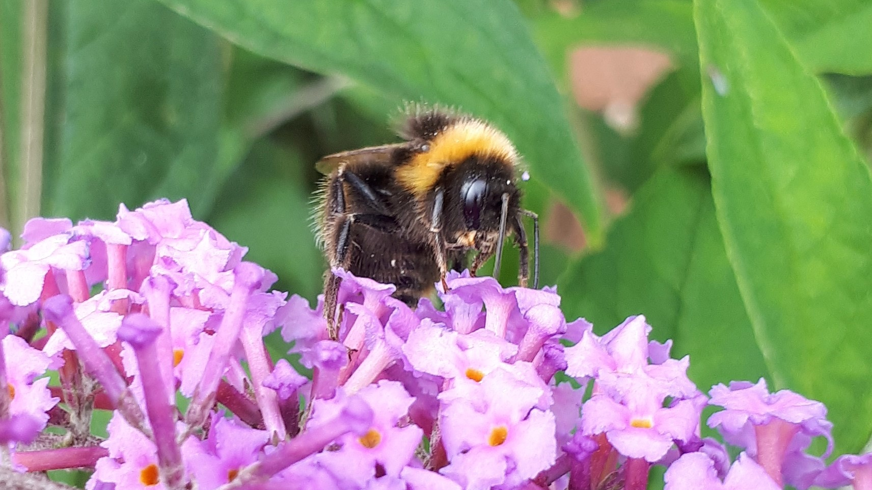
NEA Cambodia - Pollinators
Tom Breeze

Slide 2
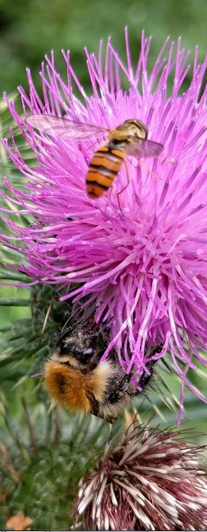
Possible outcomes of the NEA
Provide an overview of pollination services in Cambodia (Chapter 2?)
Identify the key pollinators of Cambodian crops and wild plants and summarise what we know about their status and trends (chapter 3)
Evaluate the impacts of pollinator declines on Cambodia’s agricultural sector, economy and society (Chapter 2)
Evaluate the pressures on Cambodia’s pollinators and measures to support resilient pollinator populations (Chapter 4)

Slide 3
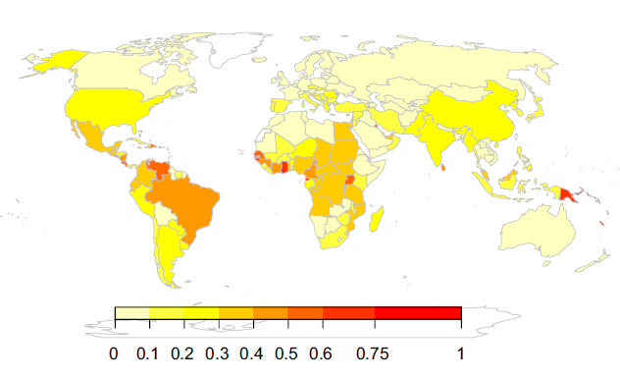
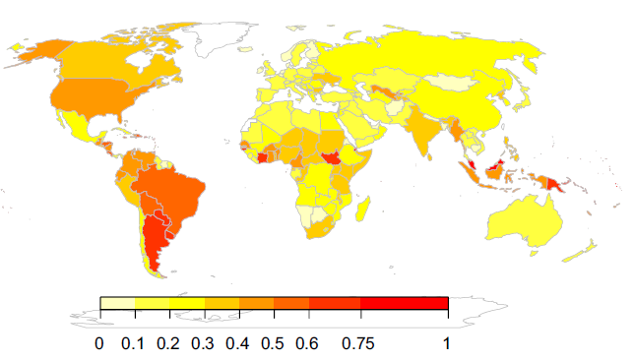
Overview of pollination
Pollination services to crops
  Globally: Pollinator dependence is growing,
  covering millions of Ha globally [1]
  In Cambodia: 235,415hs in 2020 (6% total) [2]
  Key crops include soy, sesame, oil palm [3]
[1] Aizen et al., 2019. [2] FAOSTAT, 2022. [3] Klein et al., 2007, [4] Ollerton et al., 2011

Slide 4
Overview of pollination
[2] FAOSTAT, 2022

Slide 5
Overview of pollination
Pollination services to crops
  Globally: Pollinator dependence is growing,
  covering millions of Ha globally [1]
  In Cambodia: 235,415hs in 2020 (6% total) [2]
  Key crops include soy, sesame, oil palm [3]
  This is missing cashew, durian and longan
Pollination services to wild plants
  ~80% of global flowering plants depend
  on pollinators [4]
[1] Aizen et al., 2019. [2] FAOSTAT, 2022. [3] Klein et al., 2007, [4] Ollerton et al., 2011

Slide 6
Next steps - Overview
Are there better statistics from the ministry?
What can we say about the food system these crops are in?
  Who is growing these crops? Small farmers or large growers?
  Who are they selling to? Multinationals or local markets?
How many wild plants are pollinated by animals in Cambodia?
  Do any of these have non-crop value? (e.g. as medicine)
  Are any of these culturally valuable?
Methods: Literature review (and maybe interviews?)
Aims: Identify a few key statistics for high-level messages

Slide 7
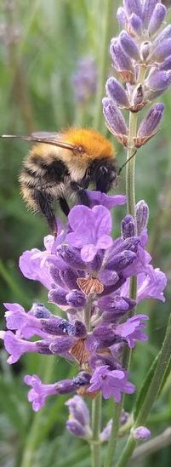
Status and Trends
What species are pollinating crops and plants?
Globally, pollination is provided by managed and wild pollinators [5]
Pollinators are identified through observational field studies [6]
Species pools can also be inferred through literature [7]
  Definite pollinators: observed as pollinators
  Likely pollinators: observed elsewhere
  Possible pollinators: not observed but have the right traits and are in the right places
[5] Garibaldi et al., 2013, [6] Potts et al., 2021, [7] Hutchinson et al., 2021

Slide 8
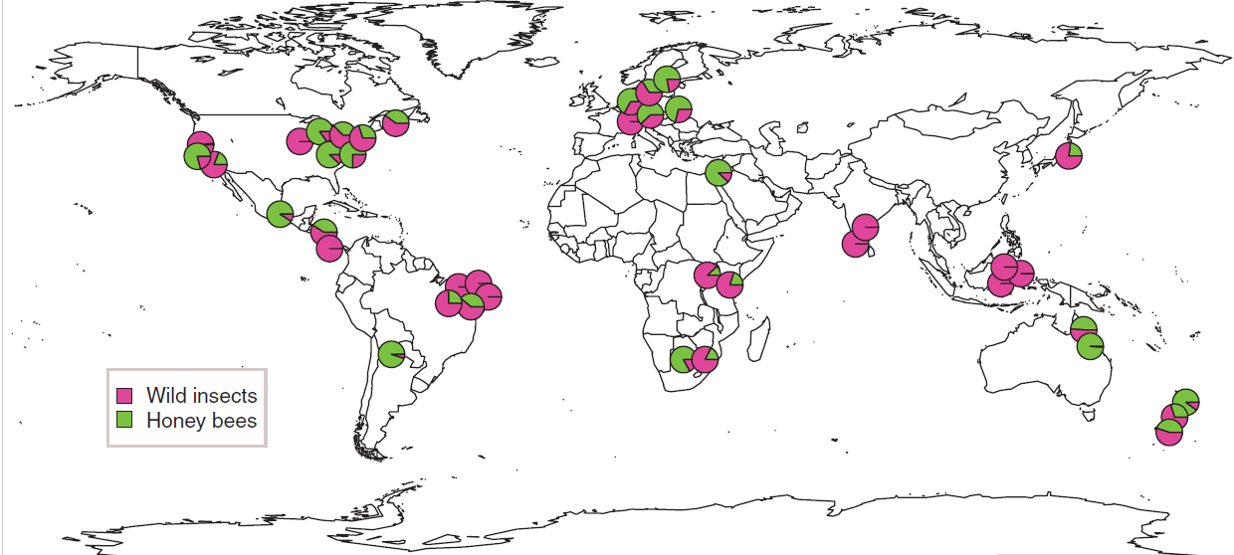
Status and Trends
[5] Garibaldi et al., 2013

Slide 9
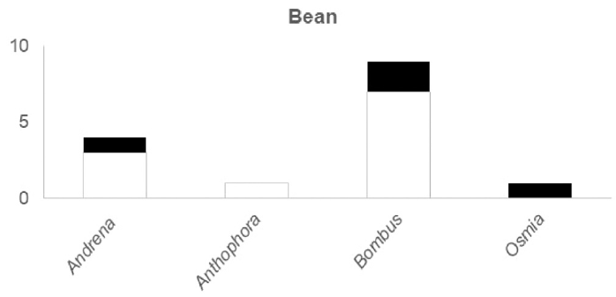
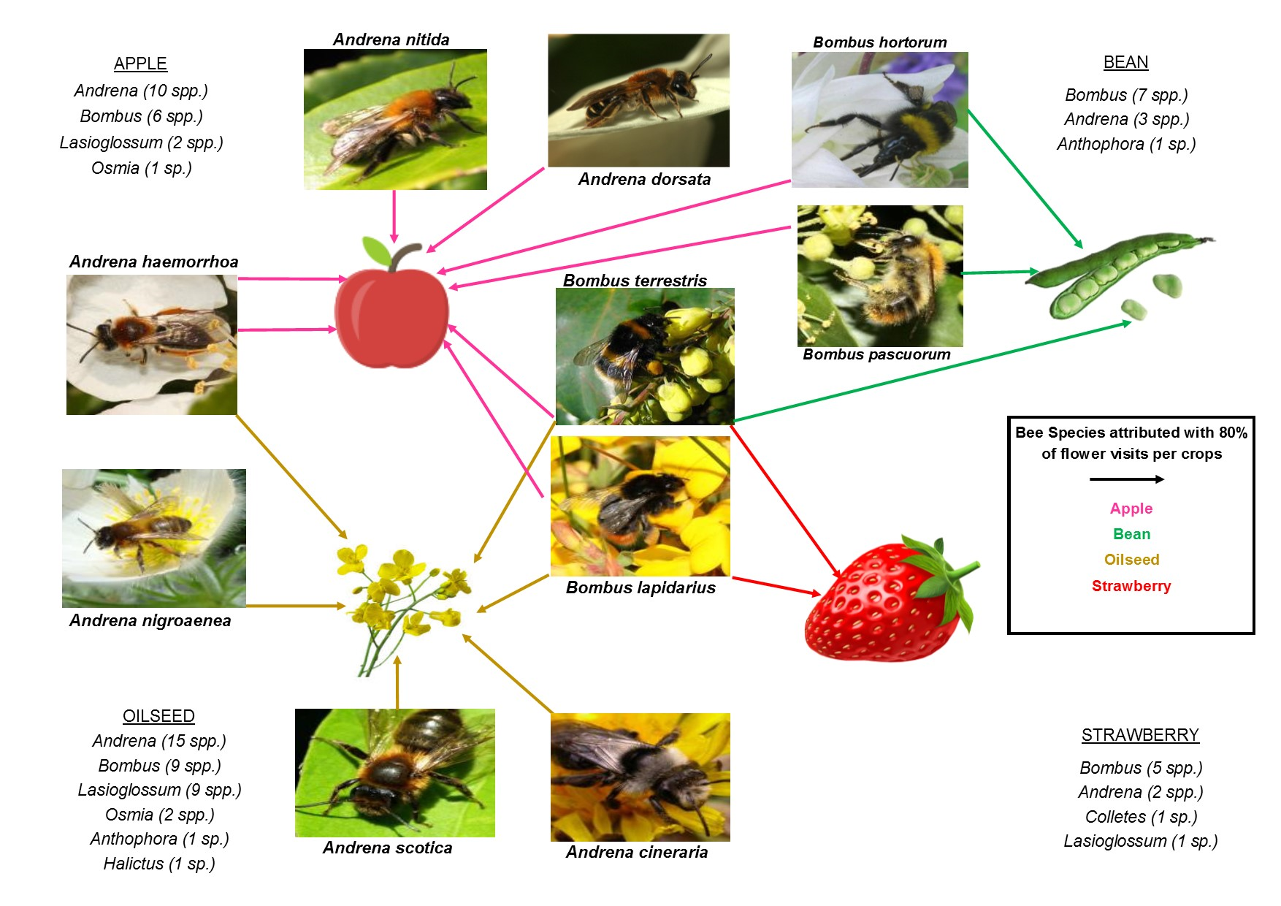
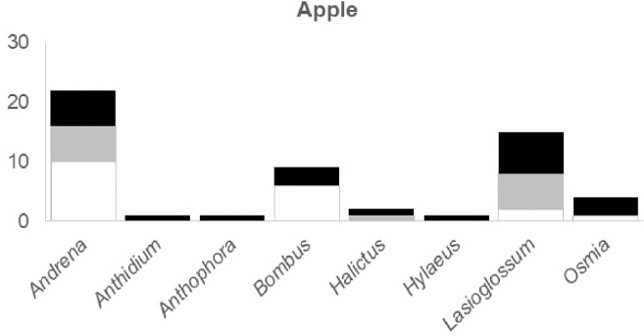
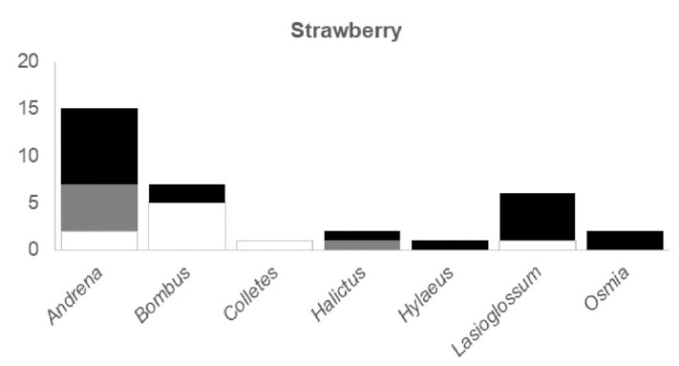
Status and Trends
Definite
Likely
Possible
[7] Hutchinson et al., 2021

Slide 10
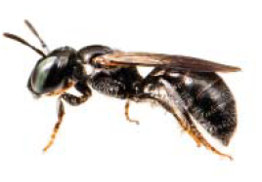
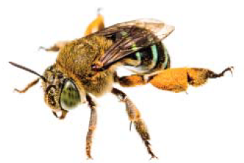
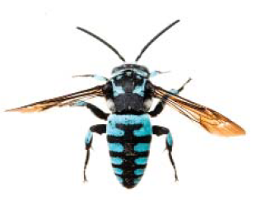
Status and Trends
Ceratina dentipes
What are the status and trends of pollinators?
Global honeybee populations are increasing [8]
but FAO data for Cambodia is lacking
82 species of wild bees are known in Cambodia
but the real number is likely to be much higher [9]
Species trends can be evaluated through monitoring
[6] or through modelled estimates [10]
Amegilla sp.
[6] Potts et al., 2021. [8] Aizen & Harder, 2009, [9] Ascher et al., 2016, [10] Powney et al., 2019
Thyreus himalayensis

Slide 11
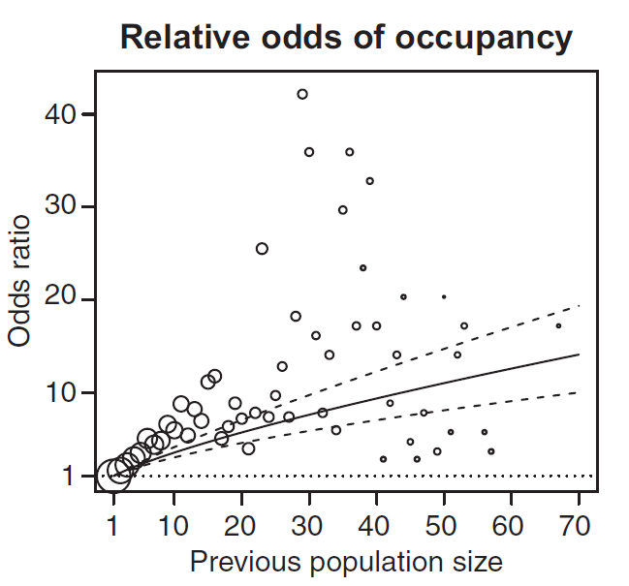
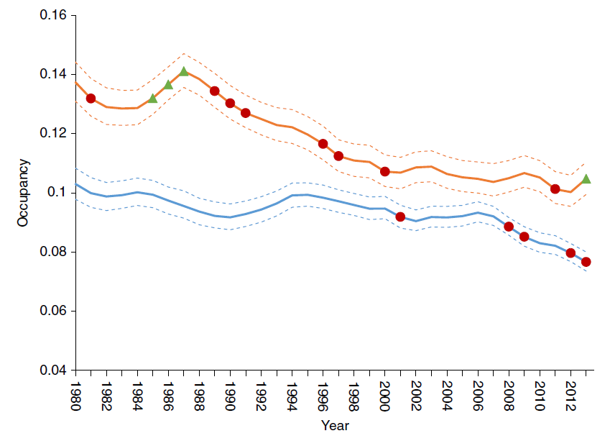
Status and Trends
(Bayesian) Occupancy models [10,11]
Based on raw presence/absence data to estimate species occupancy over time
Model the probability of a species being
found in a given cell based on repeated observations
Can be adjusted to account for recorder
bias, seasonality, year (and other priors)
Requires: spatially explicit presence/
absence data in many years, climate data
Bumblebees
Hoverflies
[10] Powney et al., 2021, [11] Schulz et al., 2020
Notes:
If anyone wants a user friendly guide, refer to https://fukamilab.github.io/BIO202/09-C-occupancy-models.html also Outhwaite et al (2018)

Slide 12
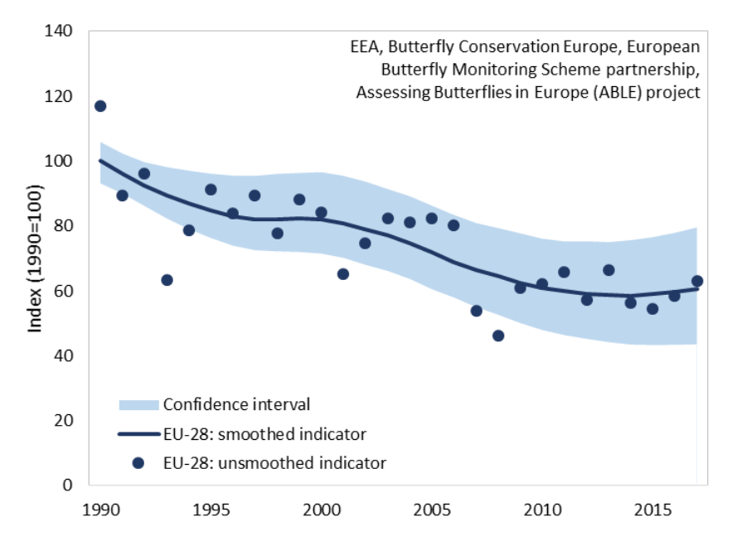
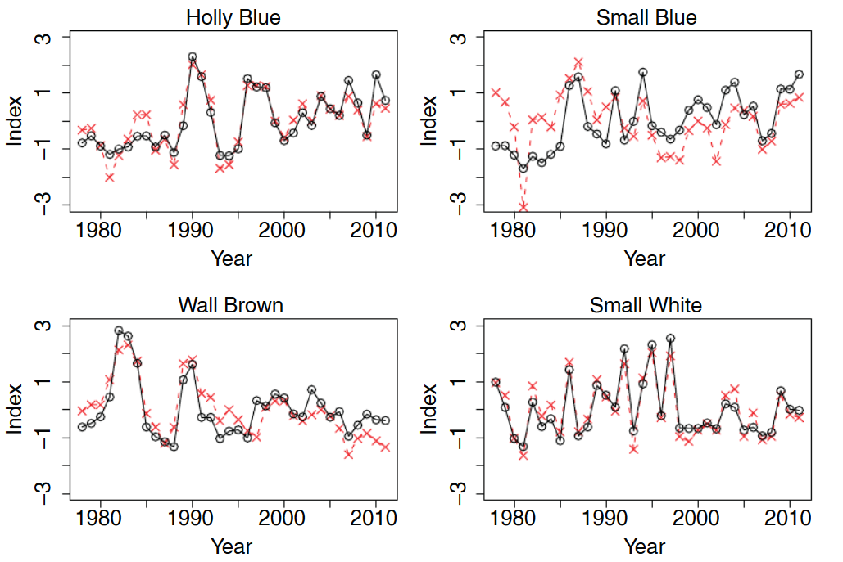
Status and Trends
Abundance index models [12]
Calculate an index of relative abundance for species, allowing for trends to be observed
Often extensions occupancy models to account for the probability of absences
Data required
  Species counts from systematic transects
  Information about the sample
  (e.g. date, time, length of transect etc.)
[12] van Swaay et al., 2019
Notes:
Van Swaay (2019) and Dennis et al (2016)

Slide 13
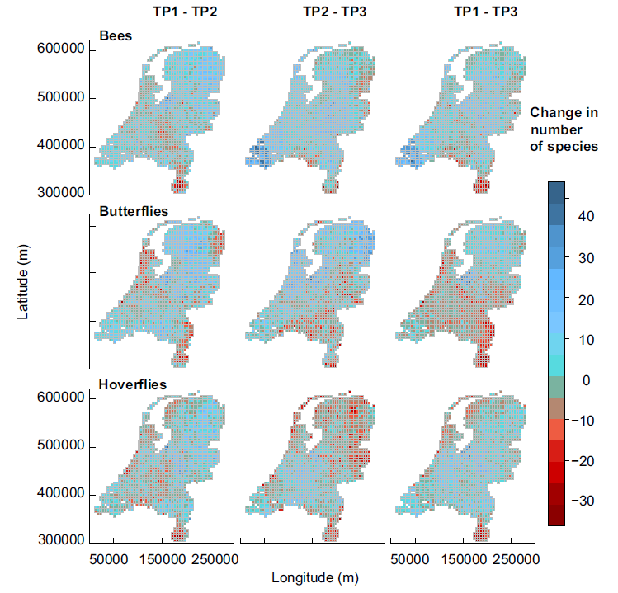
Status and Trends
Species distribution models [13]
Used to estimate change in species distribution (occupancy) based on changes in environmental factors
Data required
  Species occupancy data
  Climactic data (e.g. temperature, precipitation)
  Habitat data (e.g. habitat type)
  Species interactions where possible
[13] Aguirre-Gutierrez et al., 2017

Slide 14
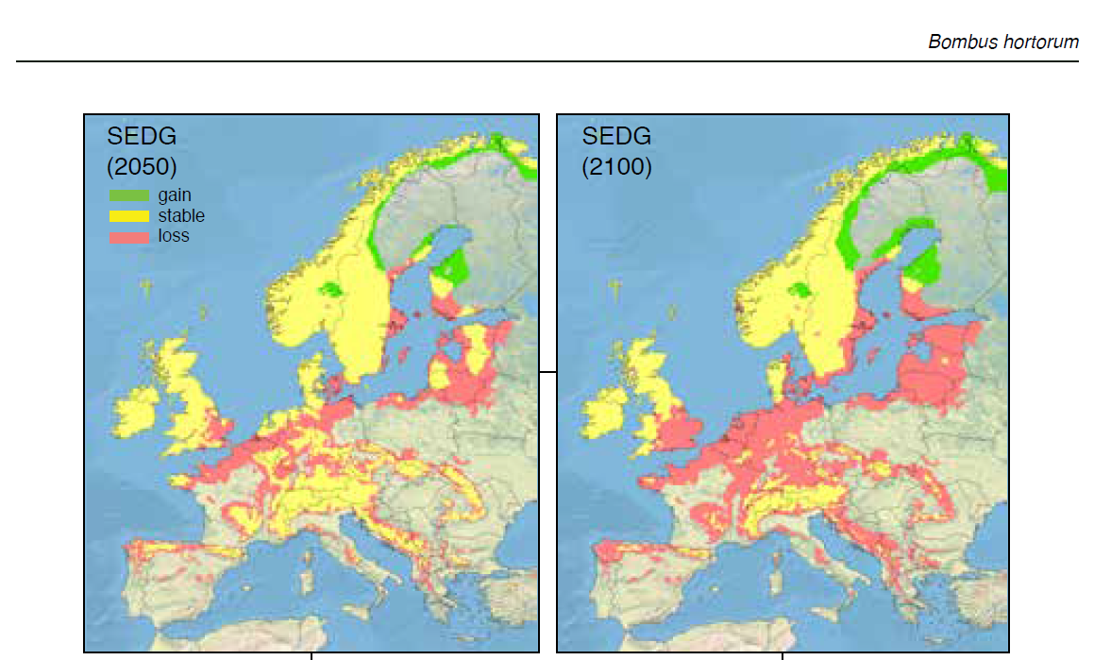
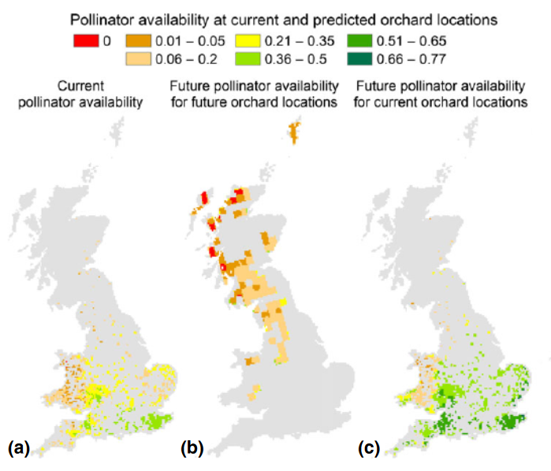
Status and Trends
Applications
[14] Polce et al., 2014
[15] Rasomont et al., 2015

Slide 15
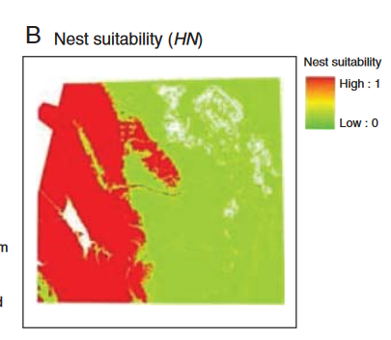
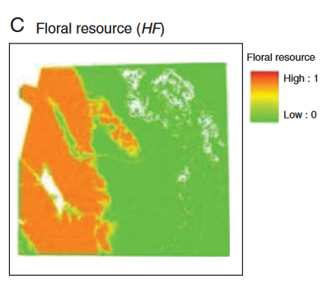
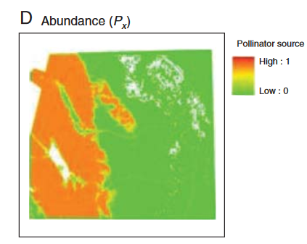
2: Status and Trends
Process based models (InVEST) [16]
Estimate the relative abundance of pollinators and their visitation rates.
Data required:
  spatial maps of habitats
  data (usually from expert opinion) on
    The habitat quality of habitat
    The foraging quality of habitat
    The reproductive rate of pollinators
    The foraging distance of pollinators
Currently only works for central place foragers (bees)
[16] Lonsdorf et al., 2009

Slide 16
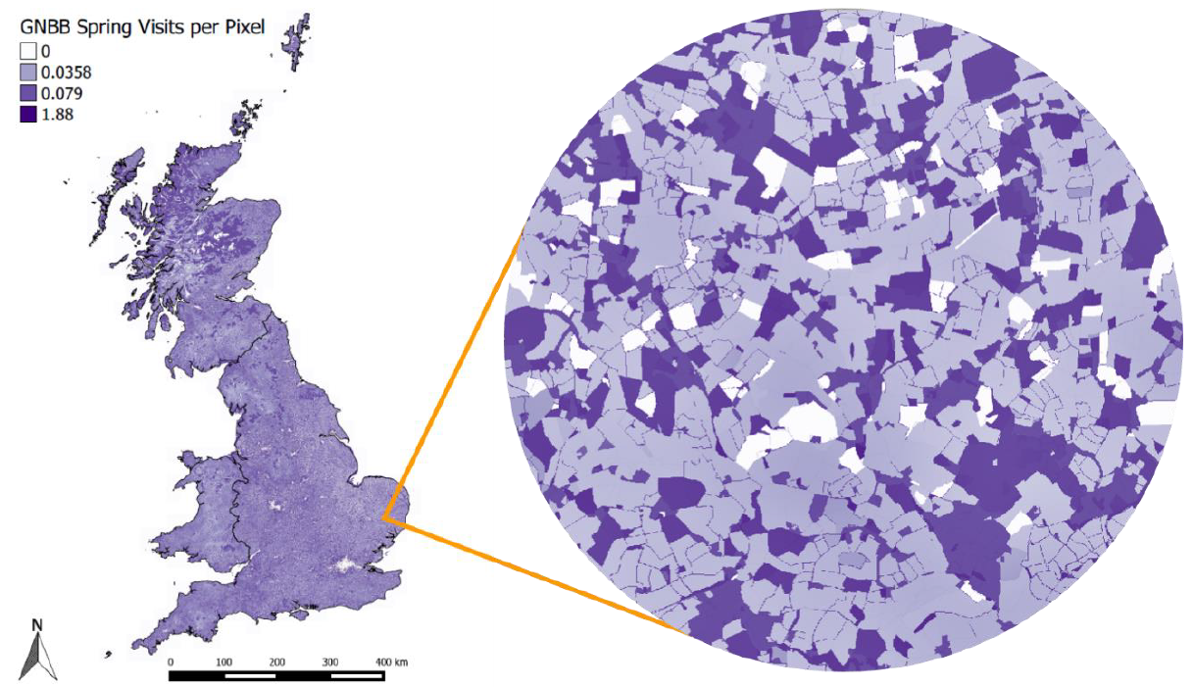
Status and Trends
Poll4Pop [17]
An advancement of InVEST
that accounts for
  Attractiveness of floral
  resources
  Seasonality of resources
Tested and validated against
transect data for the UK
This is publicly available
[17] Gardner et al., 2020

Slide 17
Next steps: Status and Trends
What information is there on the number of pollinator species and bee hives?
Is there any information on non-insect pollinators?
What information exists from Cambodia or nearby countries about the key pollinators of major crops?
Is there any spatially resolved data on any pollinators?
What spatial data is available for Cambodian habitats?
Methods: Literature search, modelling where possible
Aims: Sum up the current status of pollinators and identify key data collection for better estimates (e.g. citizen monitoring).

Slide 18
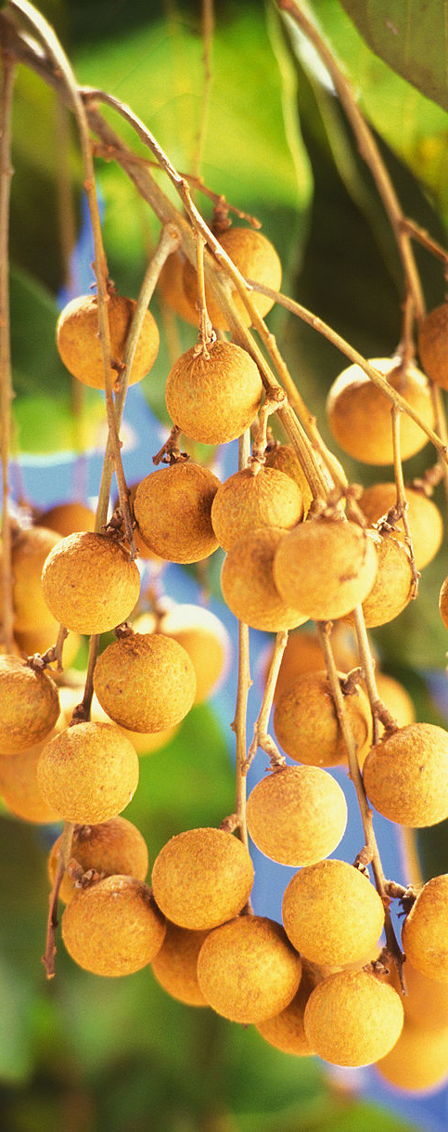
Value of pollination
What is the value of pollination to Cambodia?
Economic impacts [18]
  Globally valued at $235-577bn (2015US$) [19]
  No estimates of value for Cambodia to date
Value of pollination to key crops
  Longan in Thailand = $3,142/ha in 2013 [20]
  Longan in Thailand = $1,983-4,073/ha in 2019 [21]
  Durain in Indonesia = $117/ha (bats only) [22]
[18] IPBES, 2016; [19] Lautenbach et al., 2012, [20] Narjes & Lippert, 2016,
[21] Sritongchuay et al., 2021. [22] Sheherazade et al., 2019

Slide 19
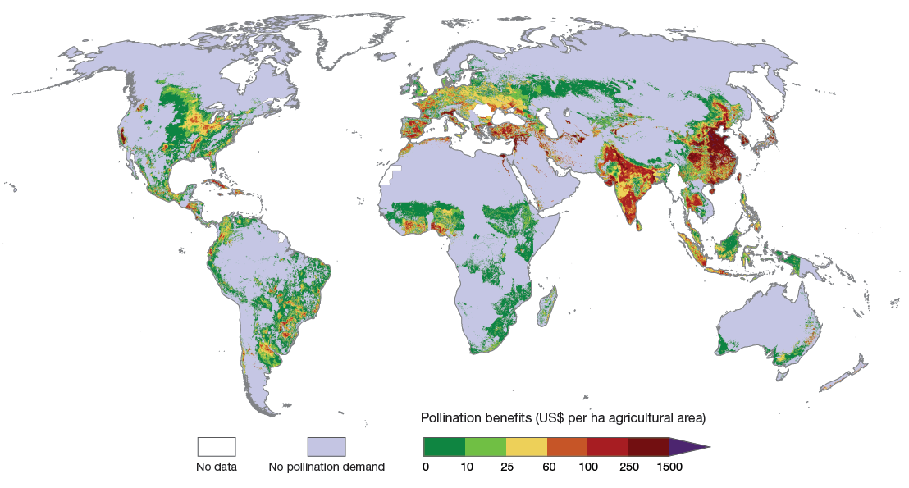
[19] Lautenbach et al., 2012

Slide 20
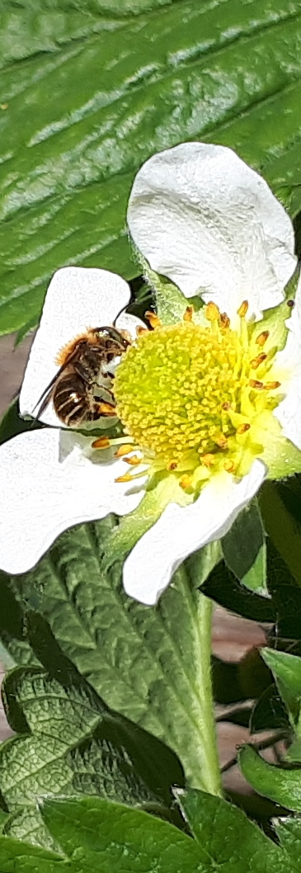
Value of pollination
Dependence Ratios [18]
  Uses data from literature to estimate the % of production
  lost in the absence of pollinators
  This % loss multiplied by the price/tonne is the value of
  pollination
Caveats: assumes that yields are already at maximum,
can miss economically important details
Data required: Dependence ratios (e.g. [3]), production
and price data (not available for Cambodia from FAO)
[3] Klein et al., 2007. [18] IPBES, 2016

Slide 21
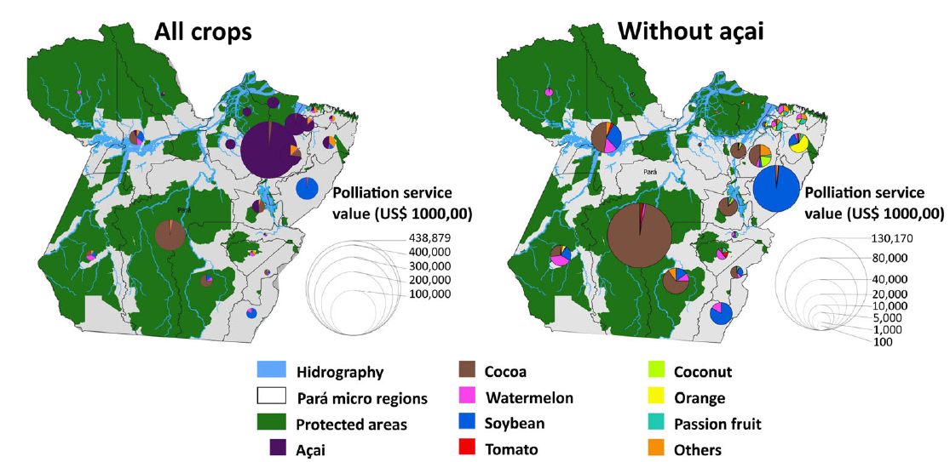
Value of pollination
Capturing the value of all crops is crucial [23]
[23] Borges et al., 2020

Slide 22
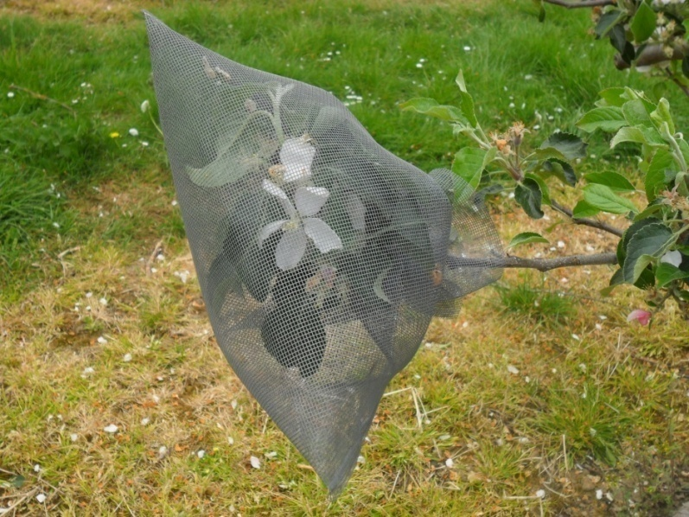
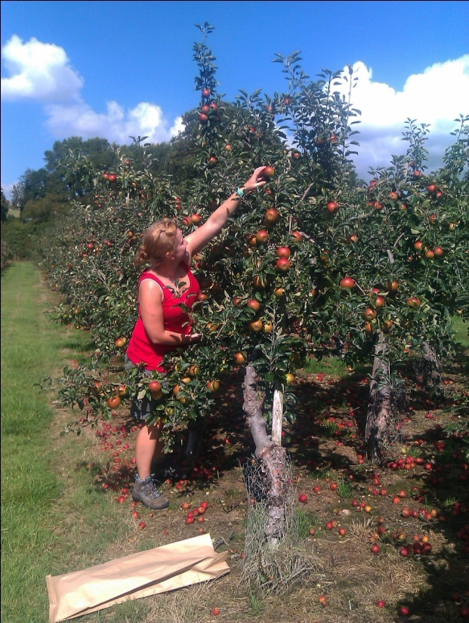
Value of pollination
Yield Analysis [18]
  Similar to Dependence ratio except based on field data
  Should also include the impact of pollination on quality
  parameters and costs and different responses by variety
  [24]
Caveats: More accurate locally but can be hard to
upscale
Data required: Yield data with and without
pollinators (a control is ideal but not essential)
[18] IPBES, 2016. [24] Garratt et al., 2014

Slide 23
Value of pollination
Cox
Gala
£2000/ha
[24] Garratt et al., 2014

Slide 24
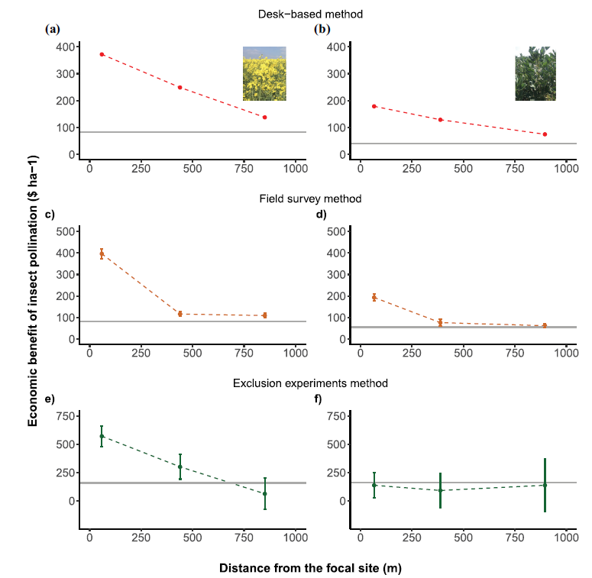
Value of pollination
Valuing pollination in local sites
Compared three methods:
  Desk based: use a dependence
  ratio but add a decay kernel
  for crop >1km from habitat
  Field survey: assume yields link
  to the number of visitors
  observed
  Yield analysis: proper exclusion
  and comparison of final harvest
  yield.
Results are comparable esp. in
close proximity to habitats
[25] Ratto et al., 2022

Slide 25
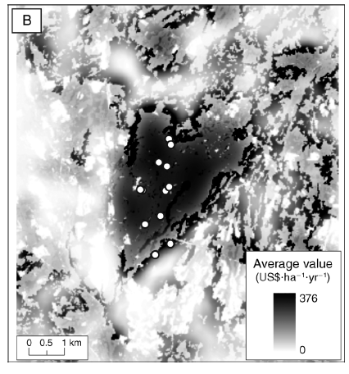
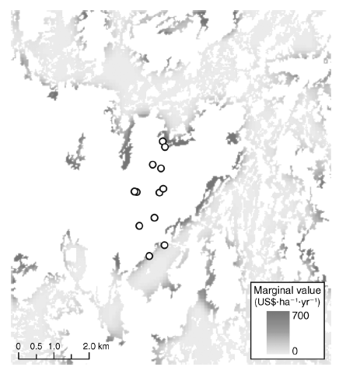
4: Impacts of Pollinator Declines
Valuing pollination at local sites
Process based models
can be extended to
compare expected
visitation with yields.
Value is the difference
with and without
each habitat patch
[26] Ricketts and Lonsdorf (2013)

Slide 26
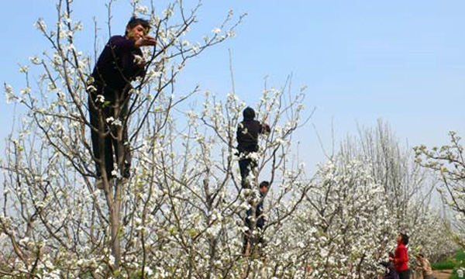
Value of pollination
Replacement cost [18]
  Equates the value of a service with the cost of replacing it
  E.g. honeybee hiring costs to replace wild bees [27]
  Replacement should deliver the same service and be
  something users are willing to pay
Caveats: Needs to be realistic, may miss externalities
Data required: information on the scale and cost of
replacement (e.g. number of hives/ha and hire price)
[18] IPBES, 2016. [27] Winfree et al., 2011

Slide 27
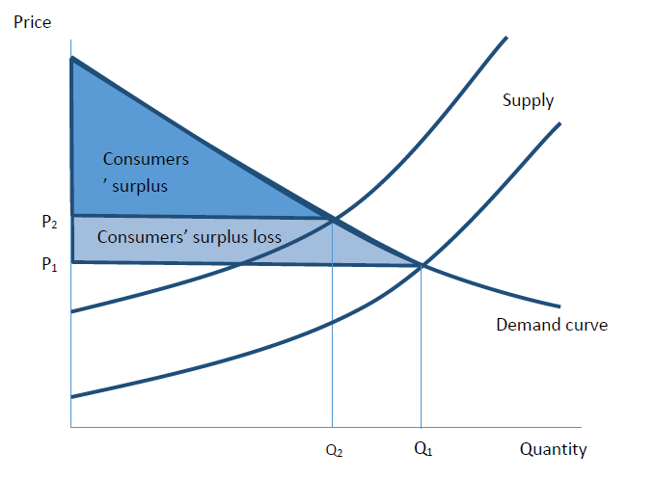
Value of pollination
Surplus analysis [18]
  Statistical models of price change in response to
  supply drop (DR or YA) or cost increase (RC)
  Captures the change in welfare for consumers
  and/or producers
Caveats: more realistic models are more complex
and often require more data [28]
Data requirements: Minimum: Supply and/or
demand elasticities. Ideal: cross-price elasticities
[18] IPBES, 2016. [28] Lippert et al., 2021

Slide 28
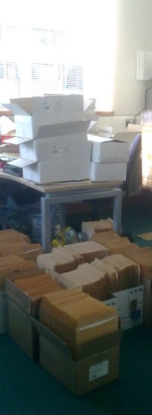
Value of pollination
Stated preferences [18]
Survey instruments designed to elicit willingness to pay
for a hypothetical market.
E.g. Willingness to pay for bee conservation [20]
  Contingent valuation: 1 fixed alternative
  Choice experiment: multiple alternatives with different
  attributes
  Deliberative monetary valuation: Choice experiments with
  additional information and discussion
Caveats: Difficult to make realistic and meaningful, vulnerable to bias
Data required: Online, in person or postal survey
with 300+ responses, realistic hypothetical policy/action.
[18] IPBES, 2016. [20] Narjes & Lippert, 2016.

Slide 29
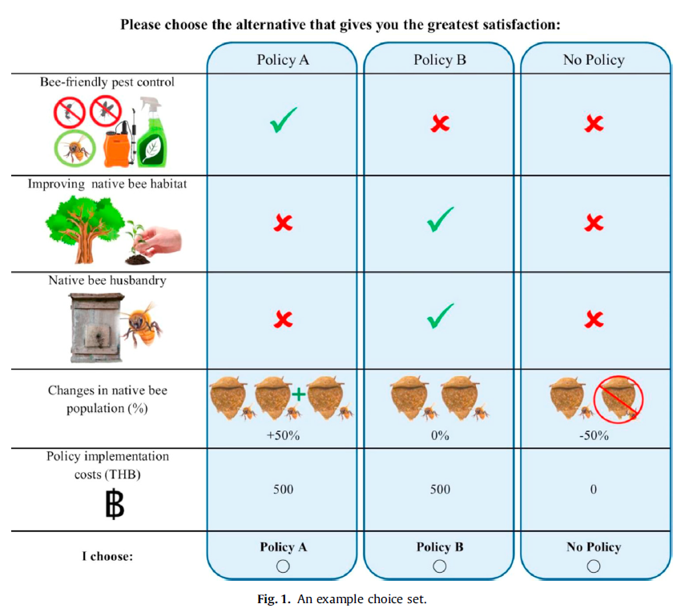
[20] Narjes and Lippert (2016)

Slide 30
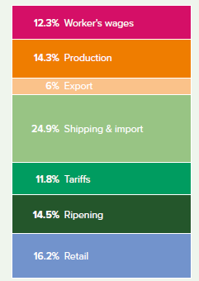
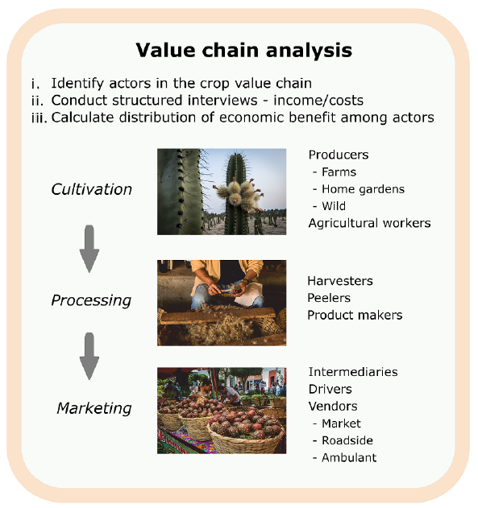
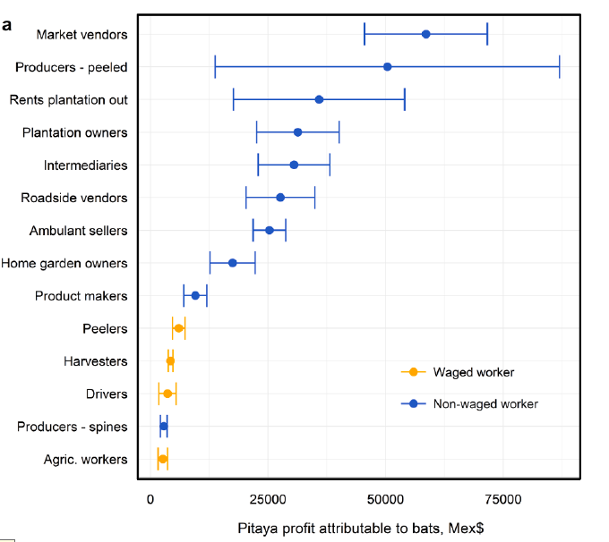
Value of pollination
The value of pollination can increase through the value chain & trade
[29] Hasnain et al, 2021. [30] Tremlett et al., 2021

Slide 31
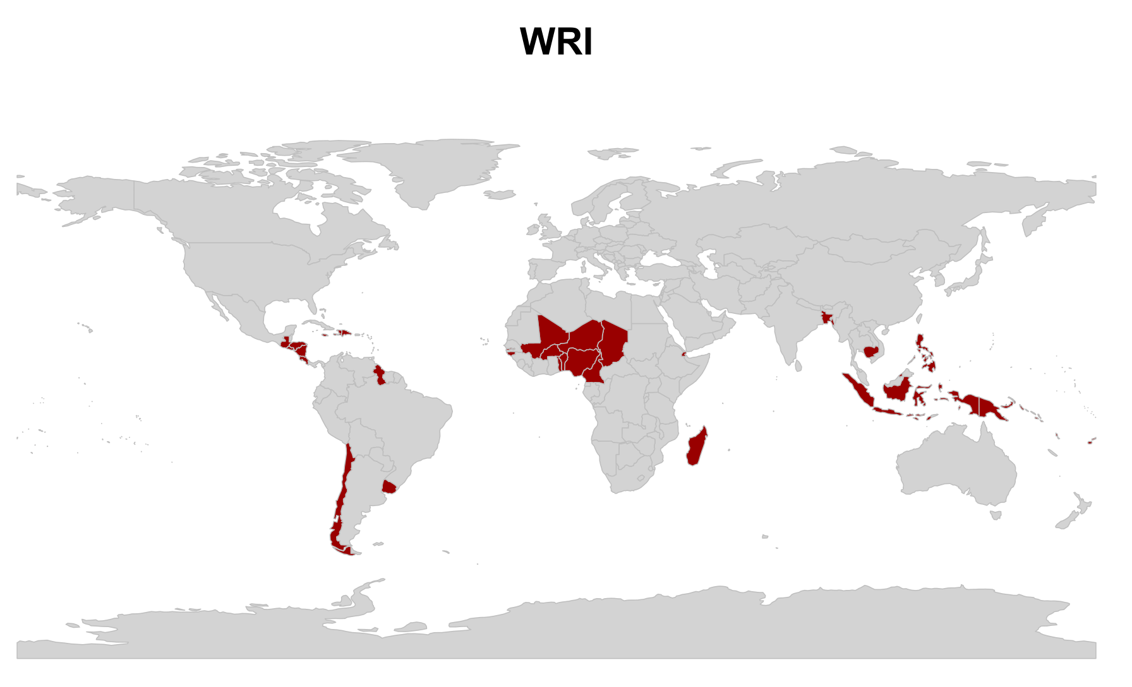
Disaster Risk
[31] Murphy et al., 2022
Countries where pollinators are lost

Slide 32
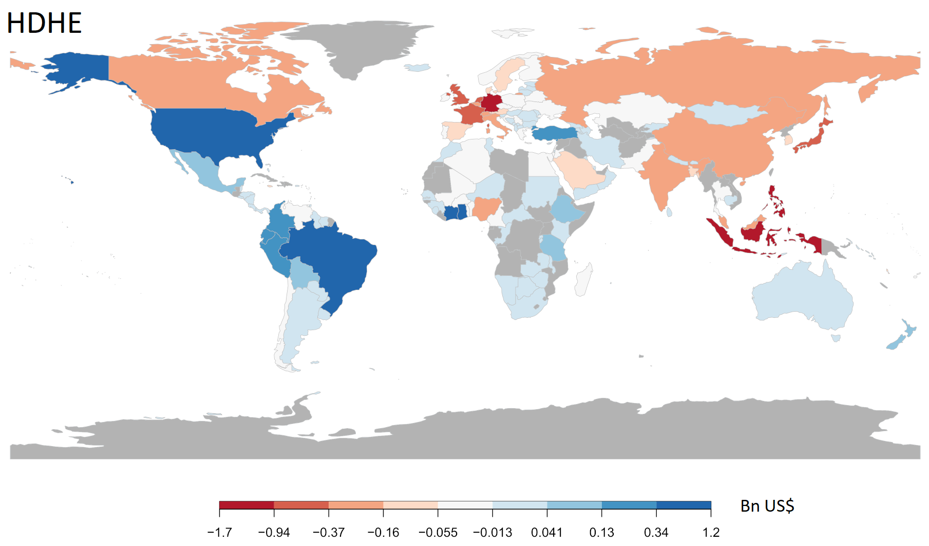
Disaster Risk
[31] Murphy et al., 2022

Slide 33
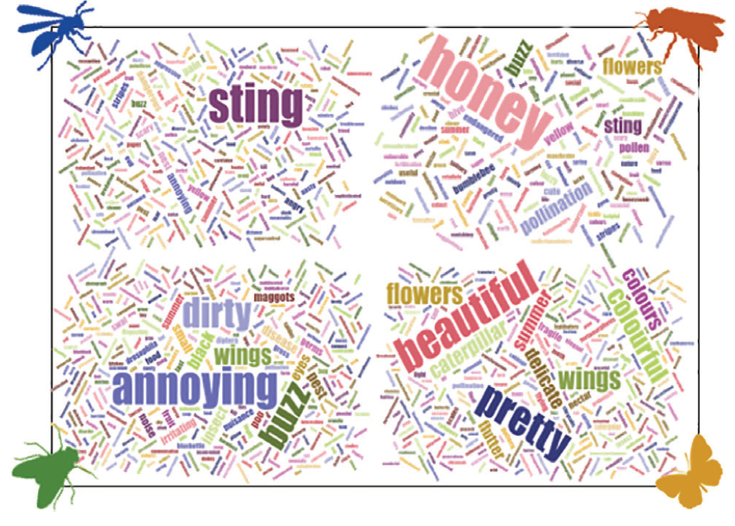
Value of pollination
Nutritional value
  Pollinators contribute to nutrition by improving
  the quantity and availability of nutrients [32]
  Method: extension of DR or YA but linked with the
  nutrients in each crop rather than market value
Social values
  Pollinators contribute cultural value in themselves
  and through pollinating culturally valuable plants
  Method: Surveys and interviews [33]
[32] Chaplin-Kramer et al., 2014. [33] Sumner et al., 2018

Slide 34
Next steps: Values
What crop price data is available for doing dependence ratio or surplus analyses?
What are the dependence ratios of key crops (e.g. Longan, Durain)?
Is there any information on crop prices through local value chains?
Is there any information on how important pollinated crops are to local diets?
Methods: Literature search, dependence ratio analysis where possible, spatial decay function modelling of key sites?
Aims: Provide estimates of the economic value of pollination services to agriculture and identify priorities for further study

Slide 35
Pressures and management
The main direct drivers of pollinator losses in Asia are [34]:
  Changes in land use (e.g. replacing habitat with farmland)
  Changes in land management (e.g. increasing fertilizer use)
  Chemical pesticide use (not just insecticides!)
  Climate change
In Cambodia [data from 2]
  Tree covered area has declined by >950,000 ha since 2000 (CIC LC data)
  Urban area has more than tripled in this time
  Between 2002-2019, fertilizer use increased by >148,000 tonnes
[34] Dicks et al., 2021

Slide 36
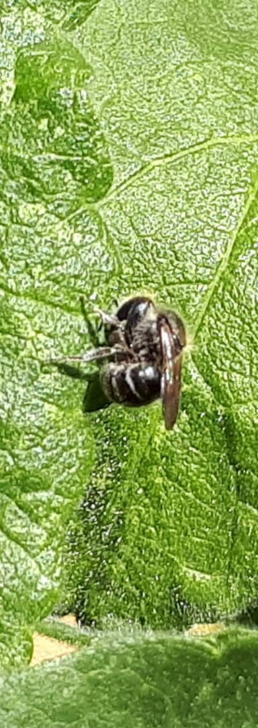
Pressures and management
Common management techniques
  Maintaining diverse landscapes (e.g. agroforestry)
  Sustainable intensification
  Reduced pesticide use (Integrated pest management)
Challenges in managing pollinators
  Land owners may not see it as a priority [35]
  Interventions need to be targeted towards the right species [36]
  Interventions will have different effects in different landscapes [37]
[35] Zhang et al., 2018. [36] Cole et al., 2020. [37] Tscharntke et al., 2012

Slide 37
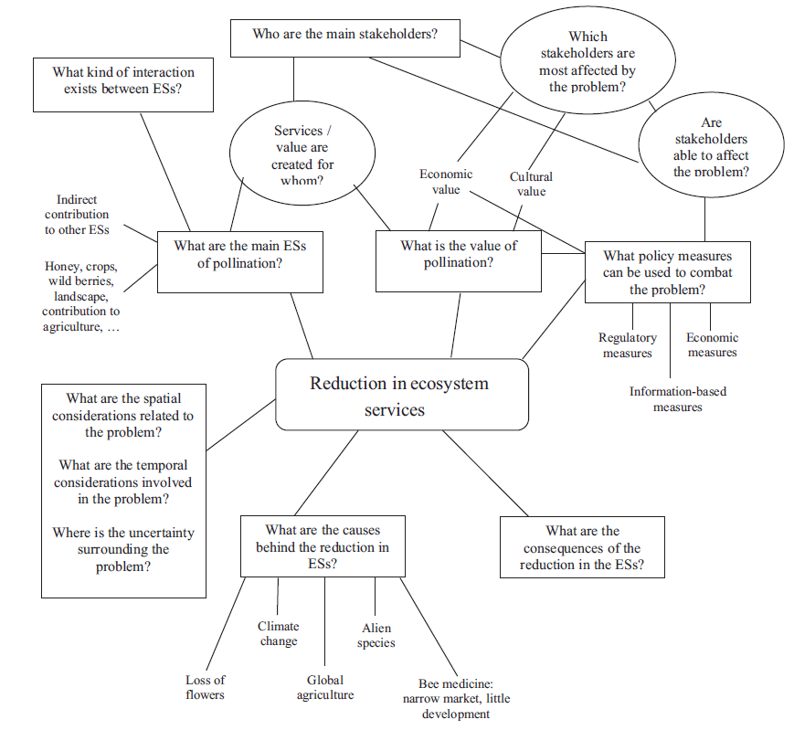
Pressures and management
Evaluating governance [38]
  Management needs clear,
  measurable objectives
  Policy can be set by different levels
  of government and by business
  Businesses may not be based in
  Cambodia (e.g. multinationals)
  Need to determine
    Who is responsible for what?
    How do pollinators affect their
    objectives?
[38] Ratamaki et al., 2015

Slide 38
Next steps: Pressures and management
What data is available on known pressures to pollinators (inc Climate change) and how spatially resolved is it?
Is there any information available on farmer knowledge of pollinators and can we survey them?
What policies may have a direct or indirect effect on pollinators?
Methods: Literature search, interviews with government and business, mind/policy mapping
Aims: Provide a review of knowledge on pressures and the possible means for different actors to manage these pressures

