Slide 1



Slide 2
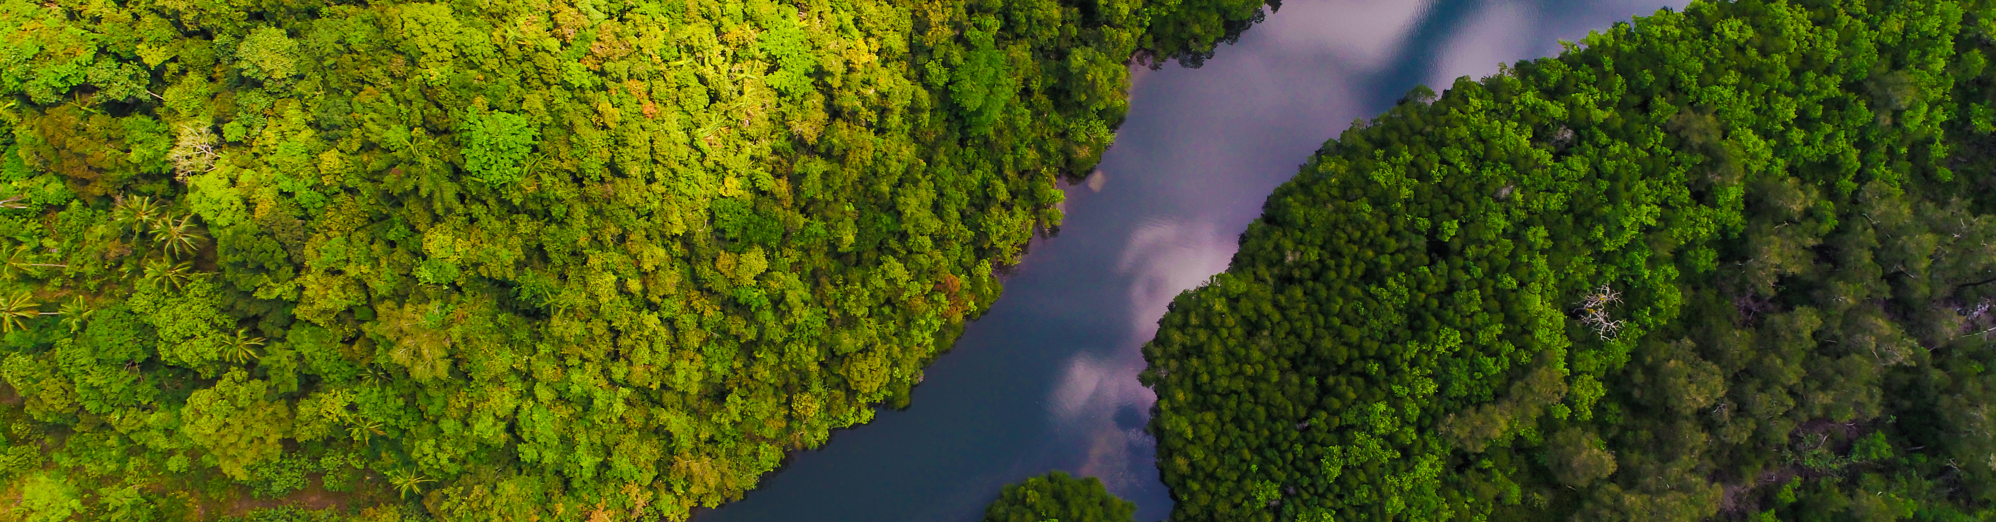


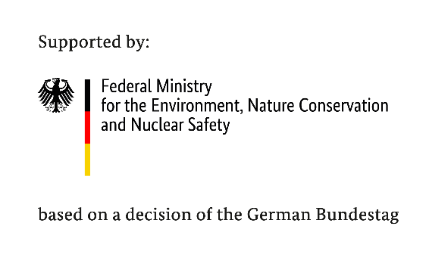

Webinar: Brazilian National Platform and assessment experiences
- National ecosystem assessment initiative -
@themorningglory

Slide 3




Housekeeping
Recording: This webinar will be recorded and will be uploaded to our NEA Initiative website. If you have any issues with this, please let us know.
Microphone and Camera: Your microphone will be muted throughout the webinar.
Questions: If you would like to comment or ask a question during the Q&A session, please type it in the chat function accessible from the bottom of your screen.
Support: If you have any technical issues, please send a direct message to [Technical Support – Mel Wheeler] via the chat.
Notes:
Before I proceed, I will just briefly cover housekeeping for today’s session…..

Slide 4
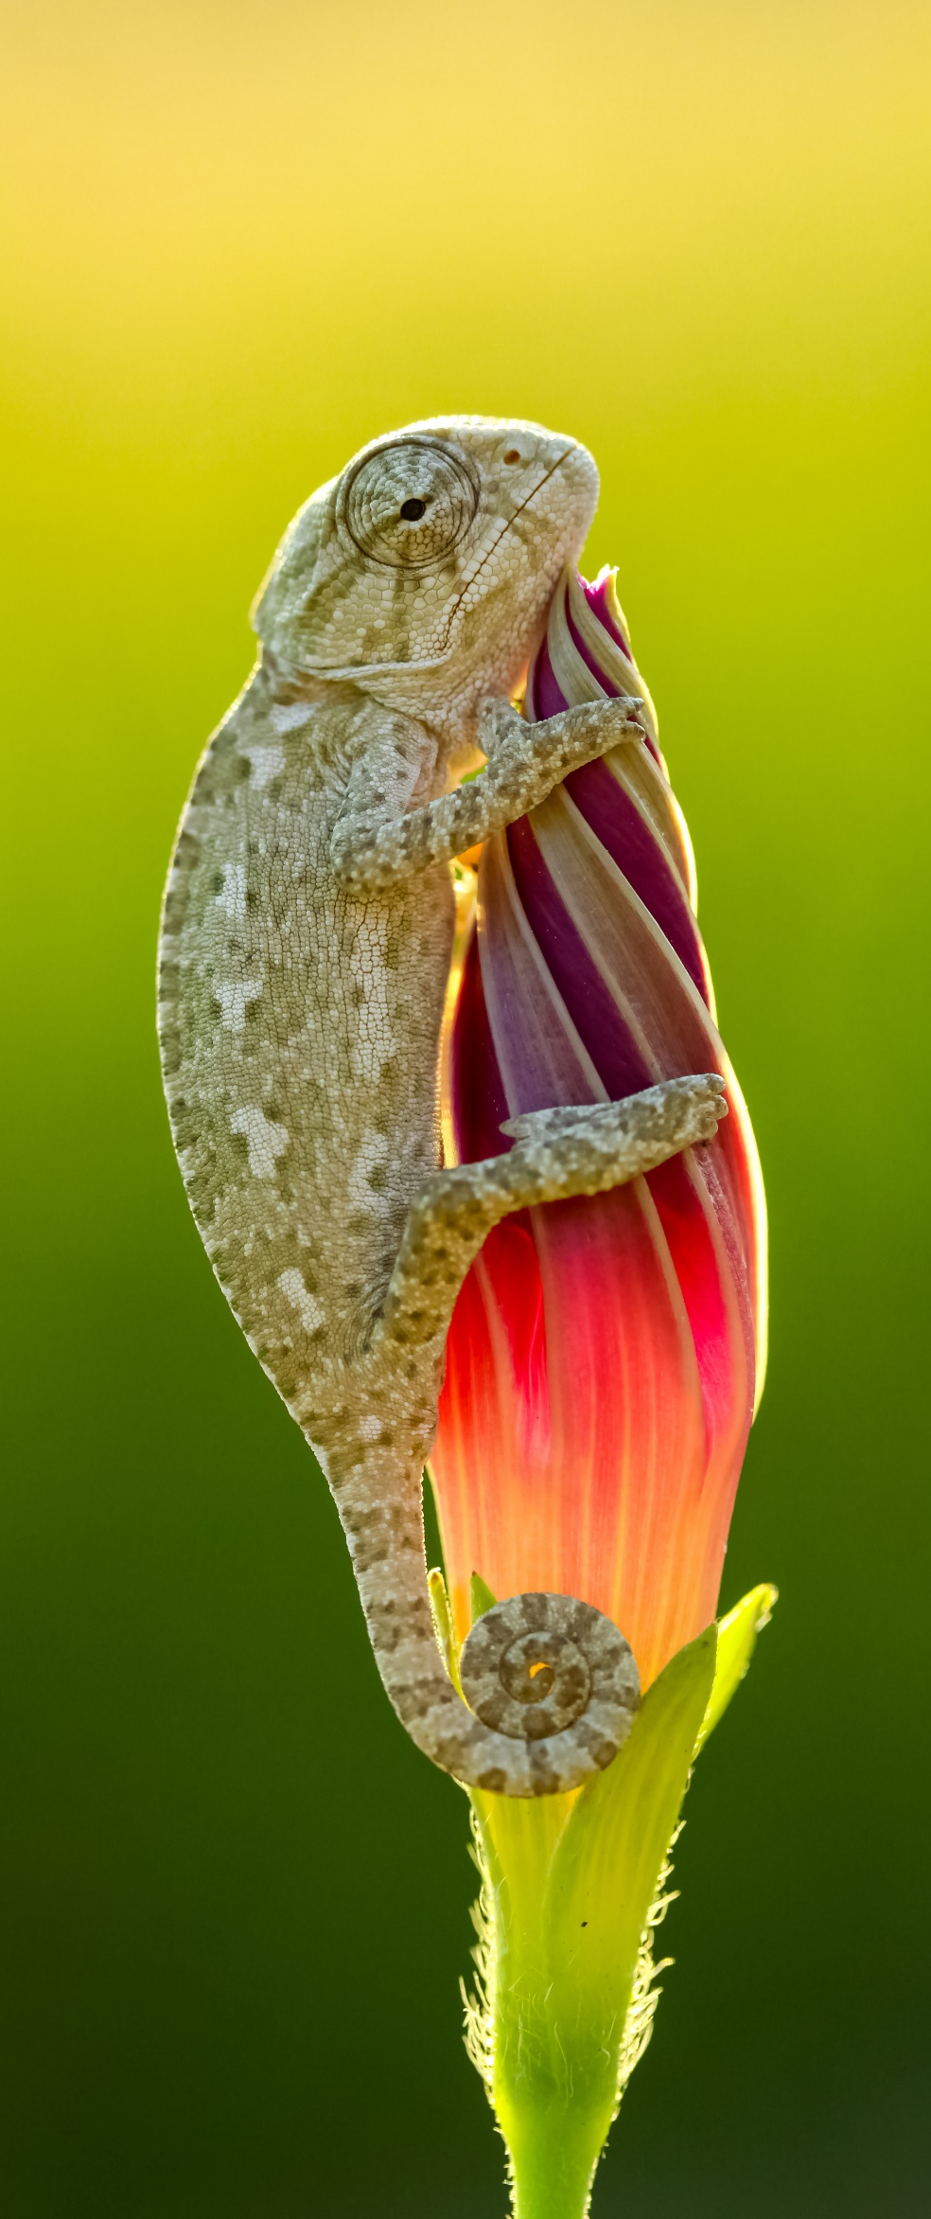

Webinar Agenda
The Brazilian Platform on Biodiversity and Ecosystem Services – BPBES
The Brazilian Assessment on Biodiversity and Ecosystem Services
Panel discussion, Q&A
@Mehmetkrc

Slide 5

In August 2021, UNEP-WCMC reconvened members and welcome new partners with the intention of strengthening the activities of the network. Since then we have delivered successfully the following open webinars:
The Sub-Global Assessment Network
Tailoring the IPBES methodology for national ecosystem assessments
Opportunities for impact from national ecosystem assessments
National ecosystem assessments to support implementation of the Convention on Biological Diversity
A community of practice that connects and supports individuals and organisations involved in sub-global ecosystem assessments
Global presentation of Vietnam’s National Ecosystem Assessment
Notes:
It is my pleasure to announce the reconvening of The Sub-Global Assessment Network (SGAN)
READ SCREEN
The SGAN aims to convene a community of practice building capacity and sharing experiences about sub-global ecosystems assessments. Members of the network may include practitioners, researchers and decision-makers.
By bringing together the National Ecosystem Assessment Initiative and the Sub-Global Assessment Network, UNEP aims to increase our support to countries undertaking sub-global ecosystem assessments and foster knowledge sharing and capacity building among those involved on assessments.
(In 2007, the United Nations Environment Programme (UNEP), in collaboration with a consortium of partners, convened the SGAN to provide ongoing support to sub-global assessments catalysed during the Millennium Ecosystem Assessment or in its follow-up.)

Slide 6
Delivered
30/05/2022
Webinar 4. Global presentation of Ethiopia’s National Ecosystem Assessment
The Sub-Global Assessment Network
08/06/2022
Webinar 5. Brazilian national platform and assessments experience
07/2022
Webinar 6. Launch of the National Biodiversity Platform Guidebook by UFZ
Join the network and stay up to date with upcoming events

Slide 7
Brazilian Platform on Biodiversity and Ecosystem Services – BPBES
2. Setting Communications Outcomes and Objectives
Prof. Carlos A. Joly
BPBES Chairman
IPBES Capacity Building Task Force

Slide 8


Prof. Carlos A. Joly
Chair

Slide 9
The Brazilian Platform on Biodiversity and Ecosystem Services - BPBES
Launched in 2015 as an IPBES-like platform
Bottom-up initiative promoted by scientists
Funded by the Brazilian Science Council and the BIOTA/FAPESP Program
Independent from the government

Slide 10
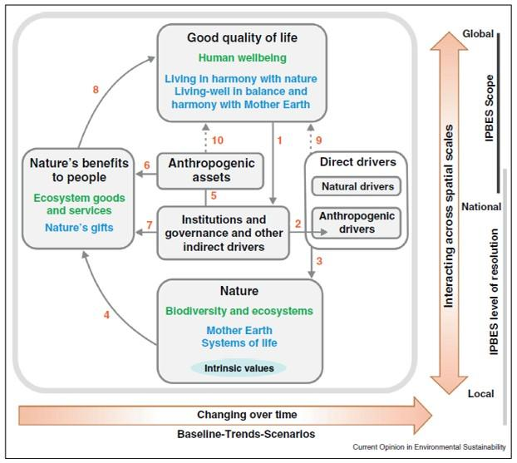

Slide 11
Mission
"Produce regular syntheses
of the best available knowledge from academic science and traditional knowledge on biodiversity, ecosystem services and their relationships to human well-being and promote dialogues with different sectors of society."

Slide 12
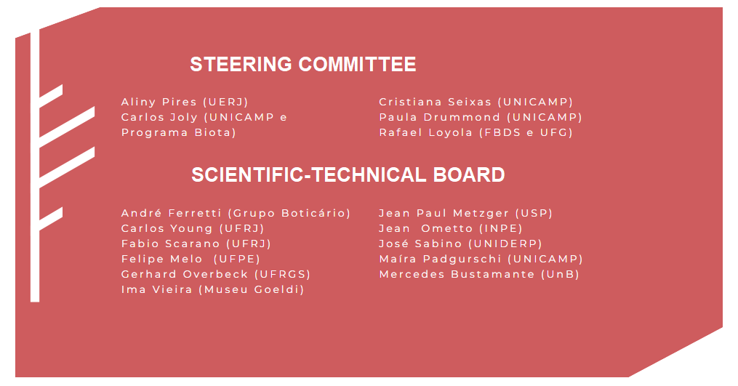

Slide 13
boundary organization

Slide 14
BPBES basis
Dialogue
Communication
Assessment

Slide 15
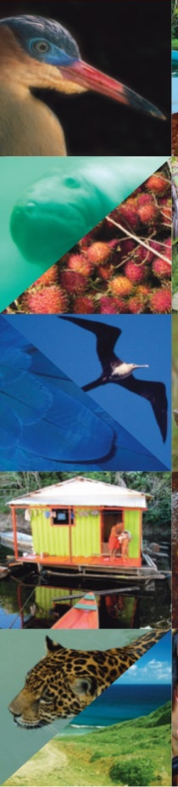
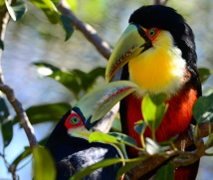


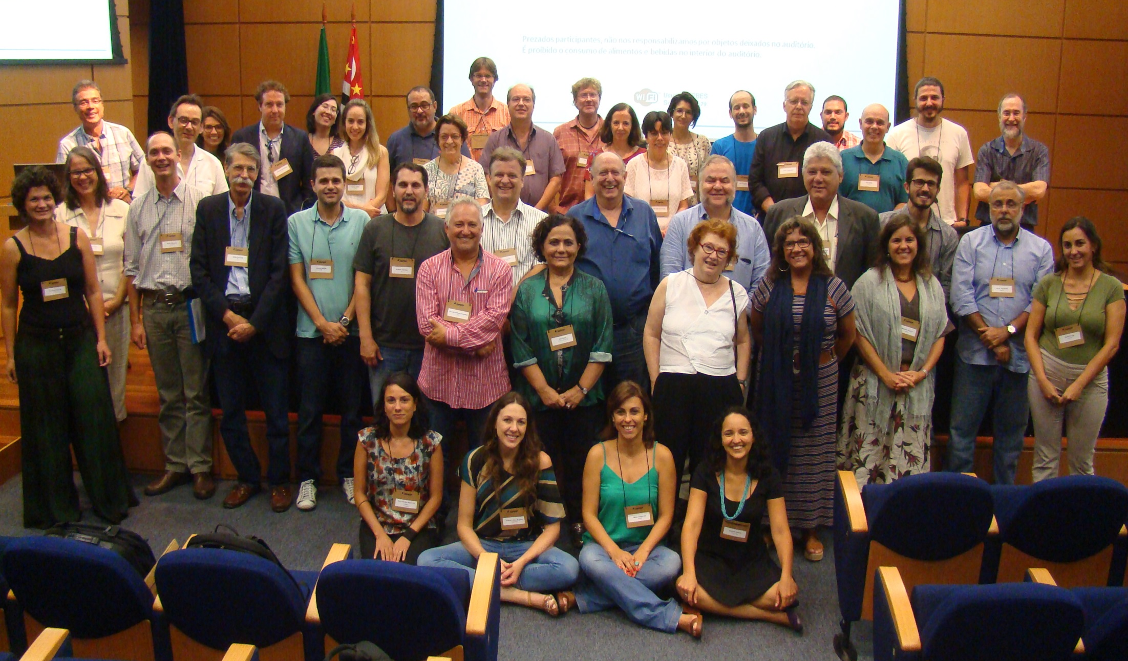

First Authors Meeting BRAZILIAN ASSESSMENT
20 FEBRUARY 2017

Slide 16
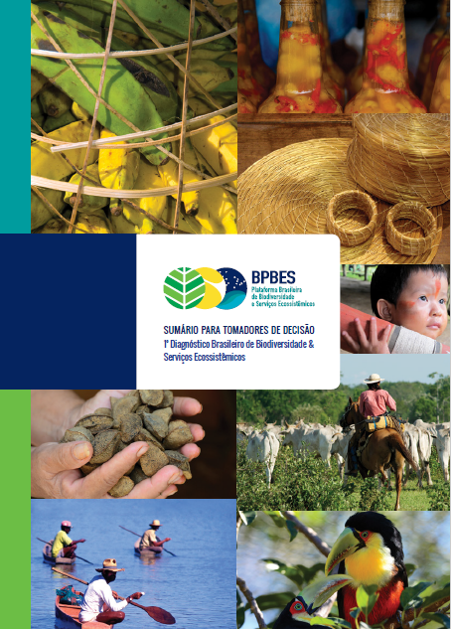
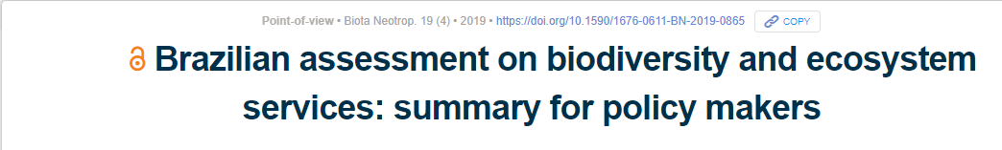
Joly el al 2019 Biota Neotropica 19(4) https://doi.org/10.1590/1676-0611-BN-2019-0865

Slide 17
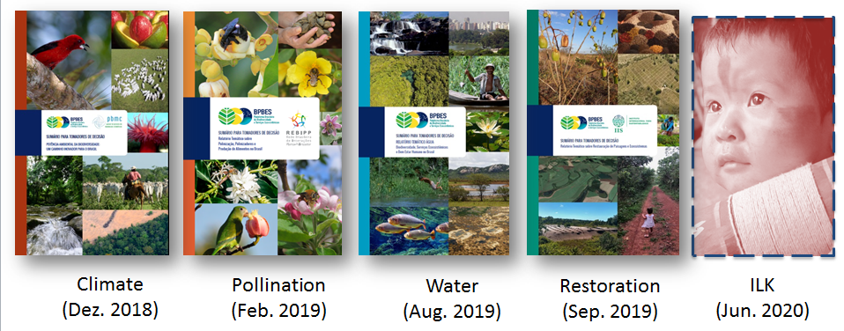
BPBES Special Reports

Slide 18

Traditional Peoples and Biodiversity in Brazil - Contributions of Indigenous Peoples, quilombolas and traditional communities to biodiversity, policies and threats
The book is a synthesis of the contributions of indigenous peoples, quilombolas and traditional communities in Brazil to the generation and conservation of biodiversity and other ecosystem services. As well as the public policies that affect them positively or negatively and the conflicts and threats to which they are subject. The research also includes assessments and recommendations from international bodies on the commitments undertaken by Brazil. Publication year: 2021
http://portal.sbpcnet.org.br/publicacoes/povos-tradicionais-e-biodiversidade-no-brasil/

Slide 19
Ingredients for the consolidation of the research network
Motivation
Leadership
Financial and institutional support
Mobilization
Technical capacity
Regional balance
Gender balance
Possible to be done

Slide 20
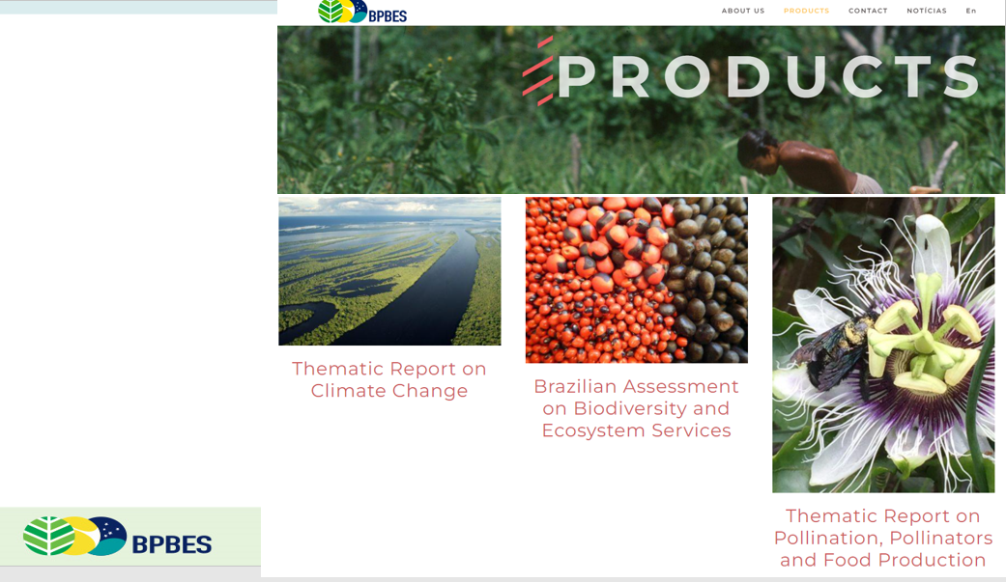
https://www.bpbes.net.br/en/products/

Slide 21
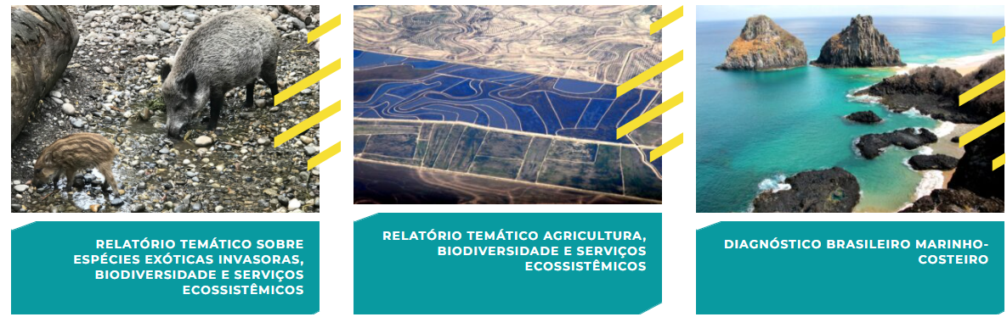
2020 - 2024

Slide 22
2020 - 2024
Brazilian Coastal Marine Assessment on Biodiversity and Ecosystem Services
Thematic Report on Agriculture, Biodiversity and Ecosystem Services
Thematic Report on Invasive Alien Species, biodiversity and ecosystem services

Slide 23
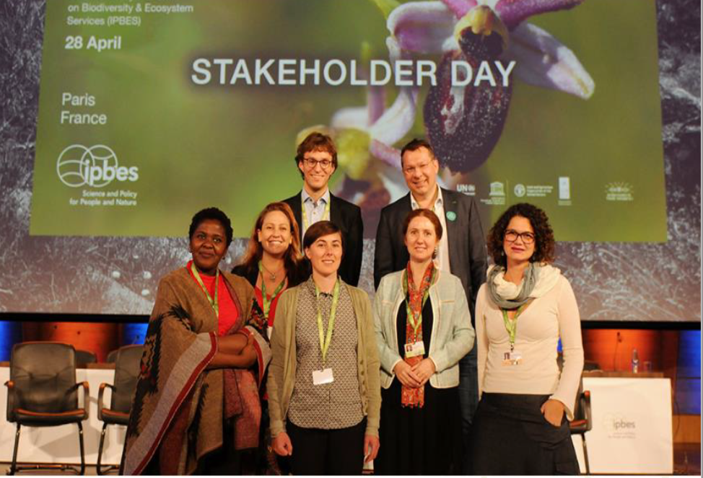

Slide 24
Thank you! www.bpbes.net.br
contato@bpbes.net.br

Slide 25
Brazilian Assessment on Biodiversity and Ecosystem Services
2. Setting Communications Outcomes and Objectives
Rafael Loyola
BPBES Executive Coordinator
Executive Director of the International Institute for Sustainability

Slide 26
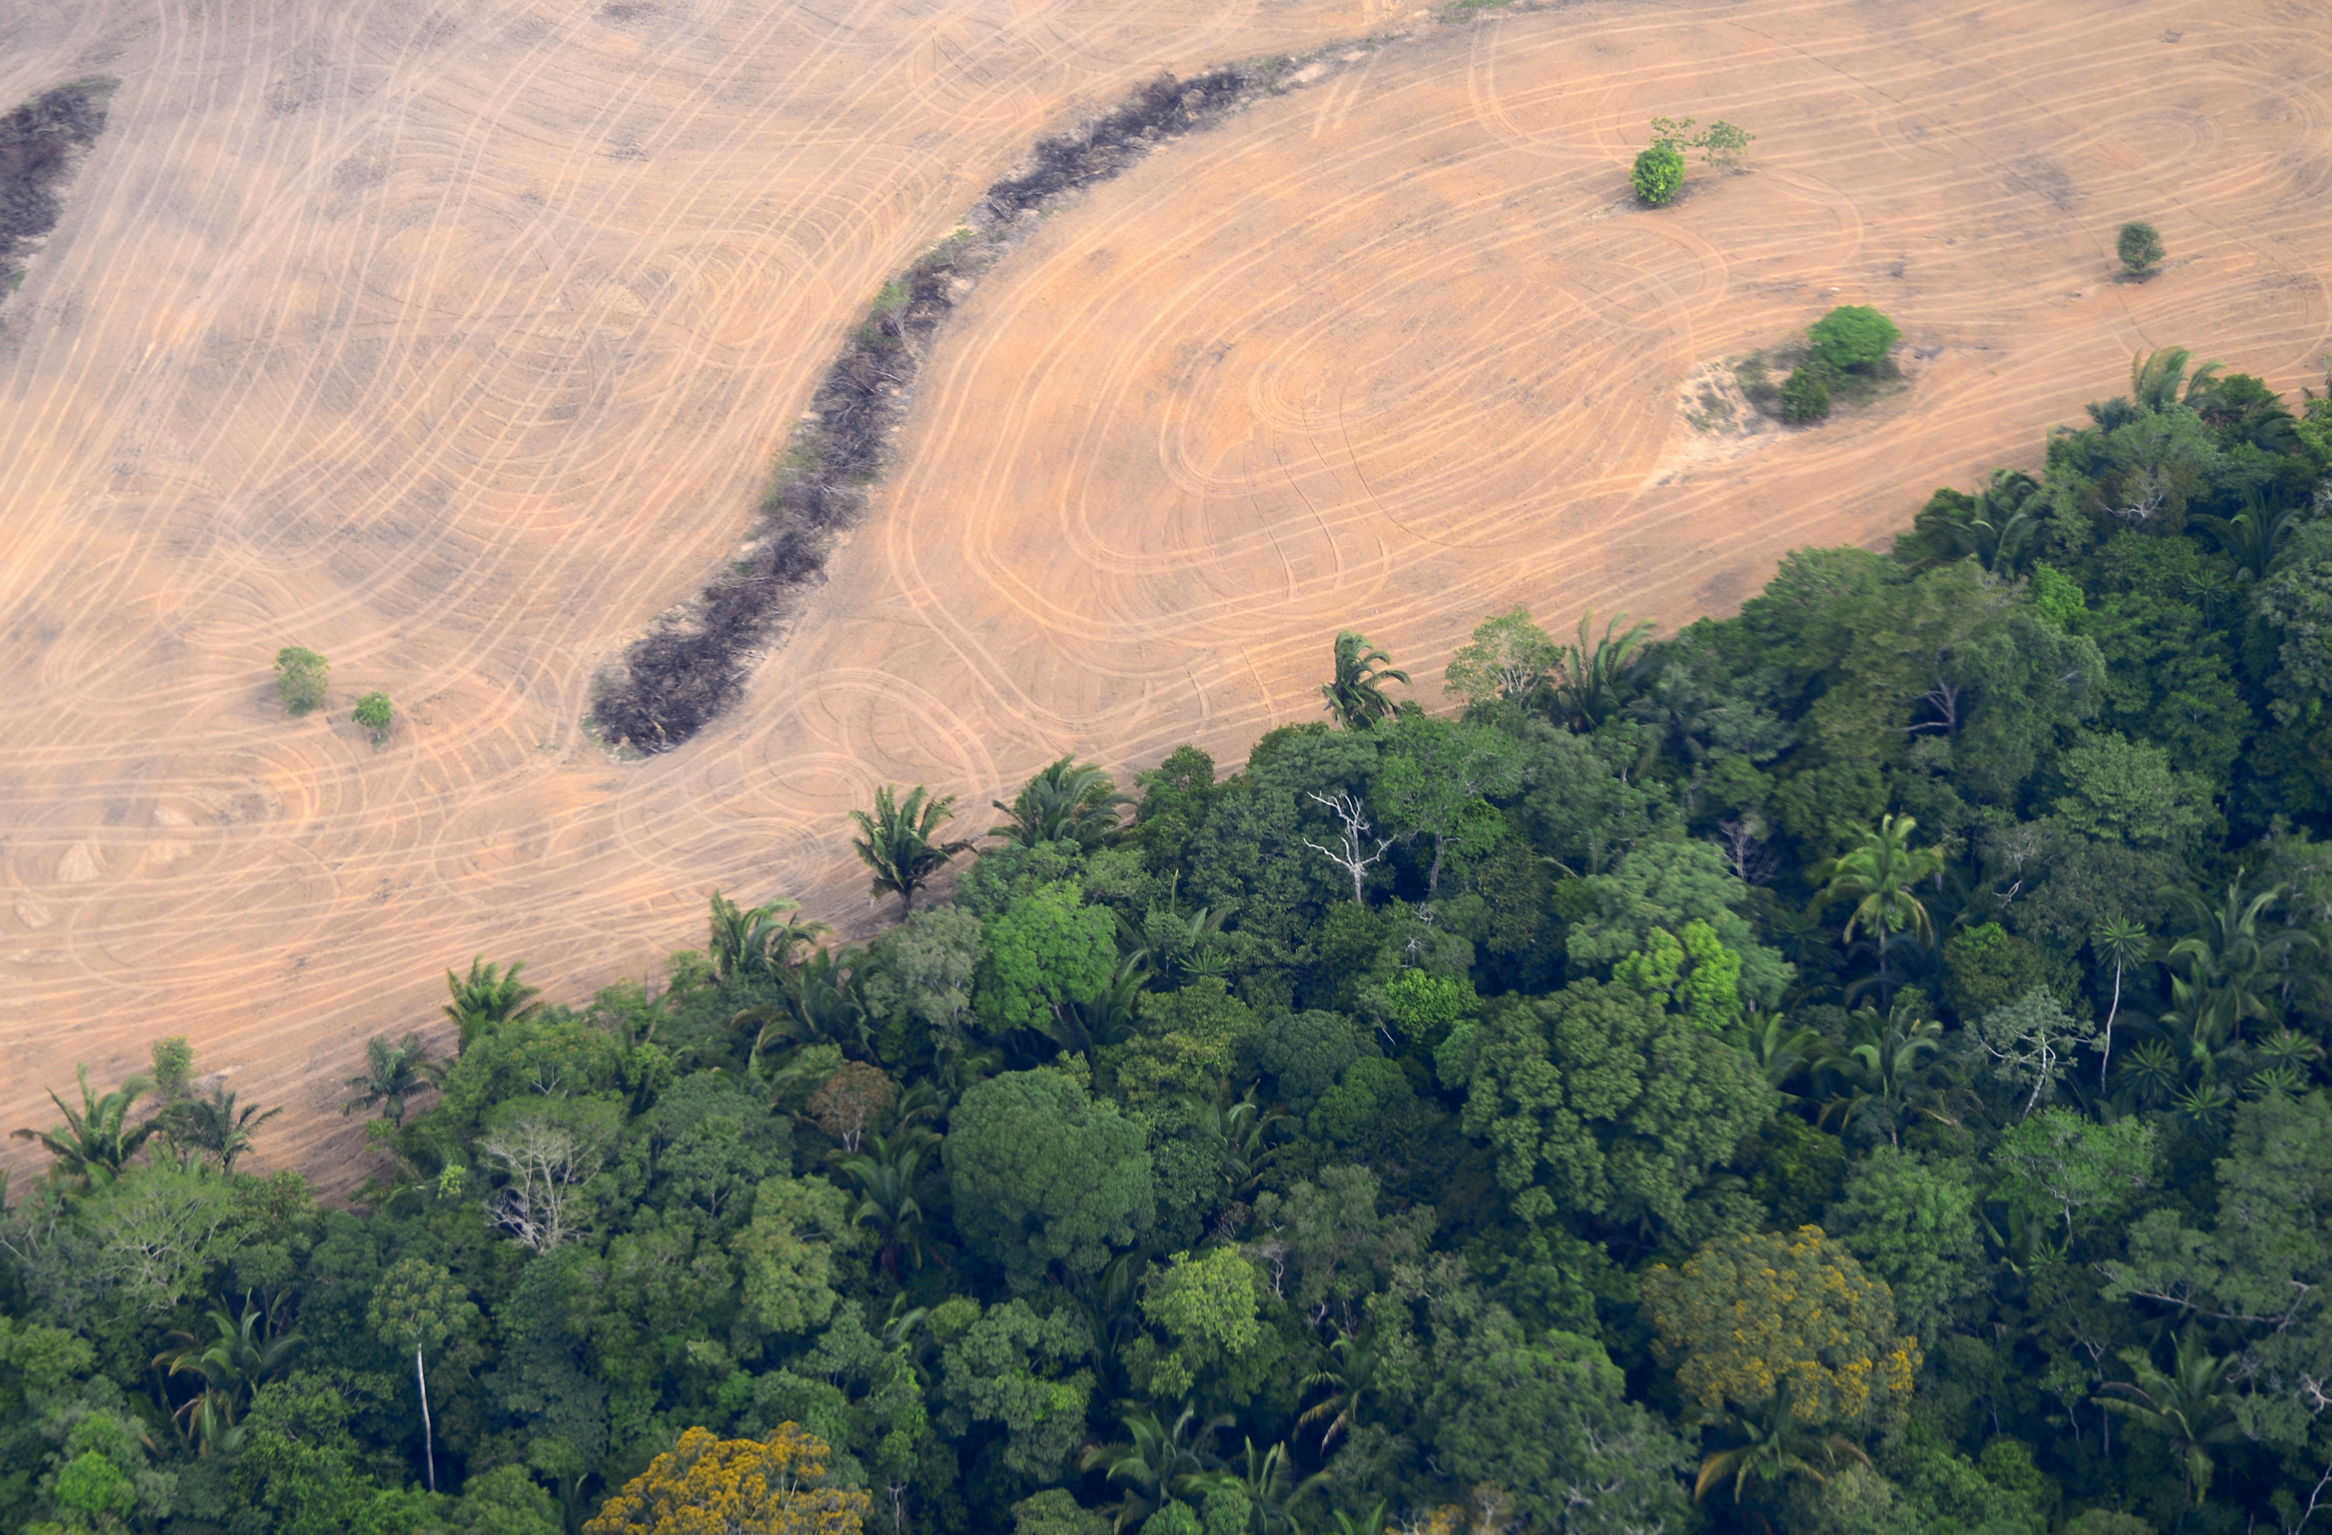







B P B E S
Brazilian assessment on biodiversity and ecosystem services
Rafael Loyola
Executive Director | International Institute for Sustainability, IIS
Executive Coordinator | Brazilian Platform on Biodiversity and Ecosystem Services, BPBES
Rafael Loyola

Slide 27
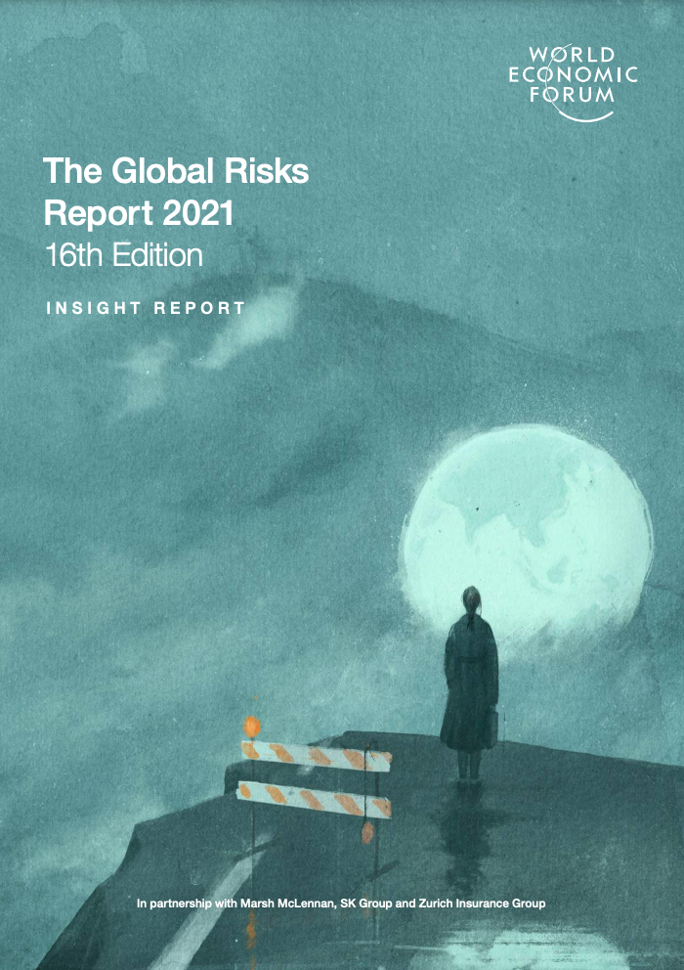
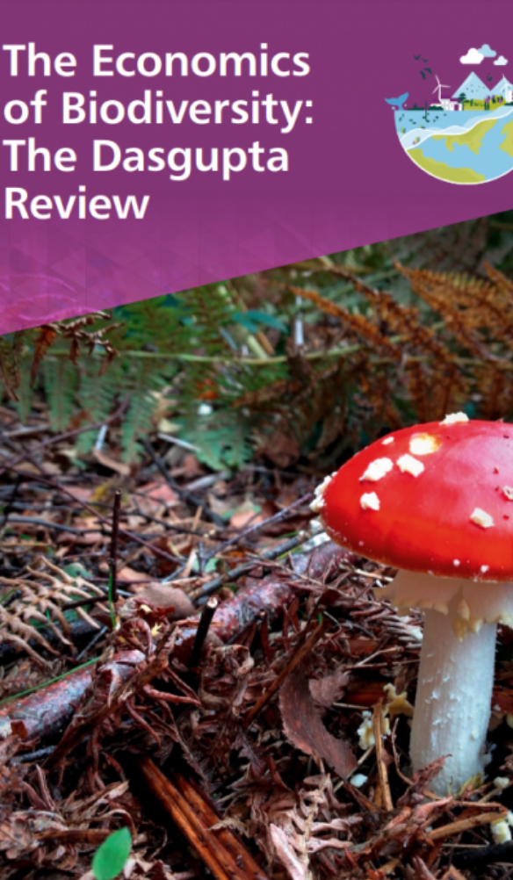
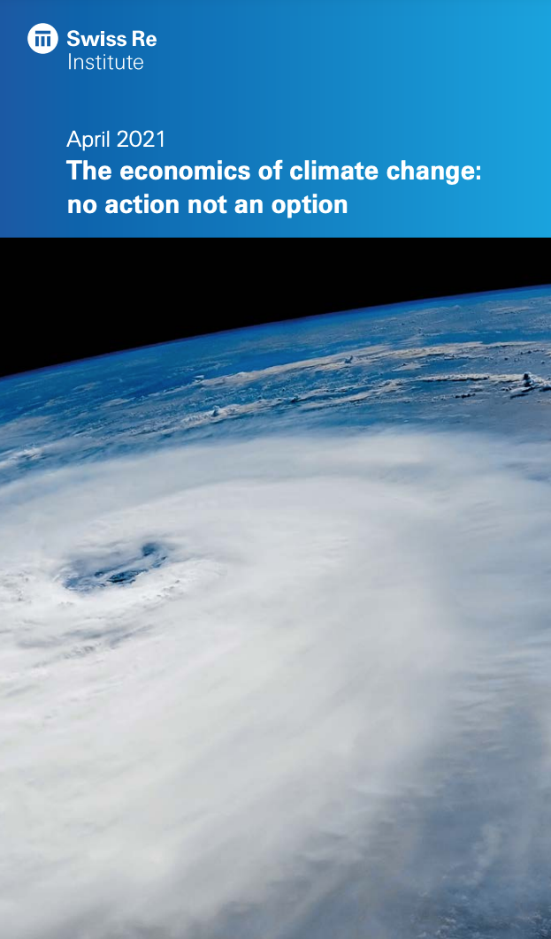

Recent reports reinforce IPBES conclusions

Slide 28

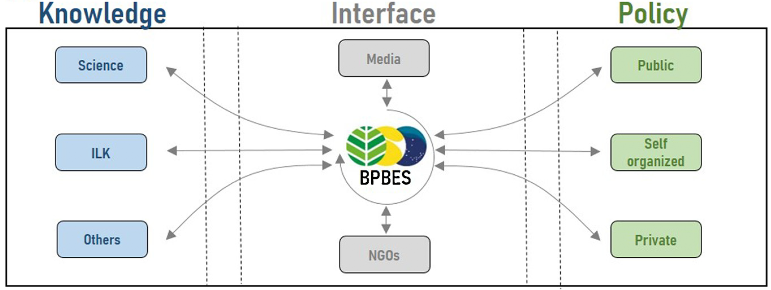
Boundary chains created by BPBES

Slide 29

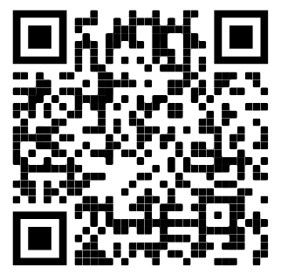
BPBES 1st National Assessment

Slide 30
ASSESSMENT STRUCTURE
Introduction;
Conceptual framework and definitions;
Nature and quality of life;
Trends and impacts of drivers of biodiversity and ecosystem services degradation and restoration;
Current and future interactions between nature and society;
Governance and decision-making options across scales and sectors.
Notes:
The assessment was developed in close consultations with representatives of the federal government, civil society, the private sector, and indigenous peoples.

Slide 31
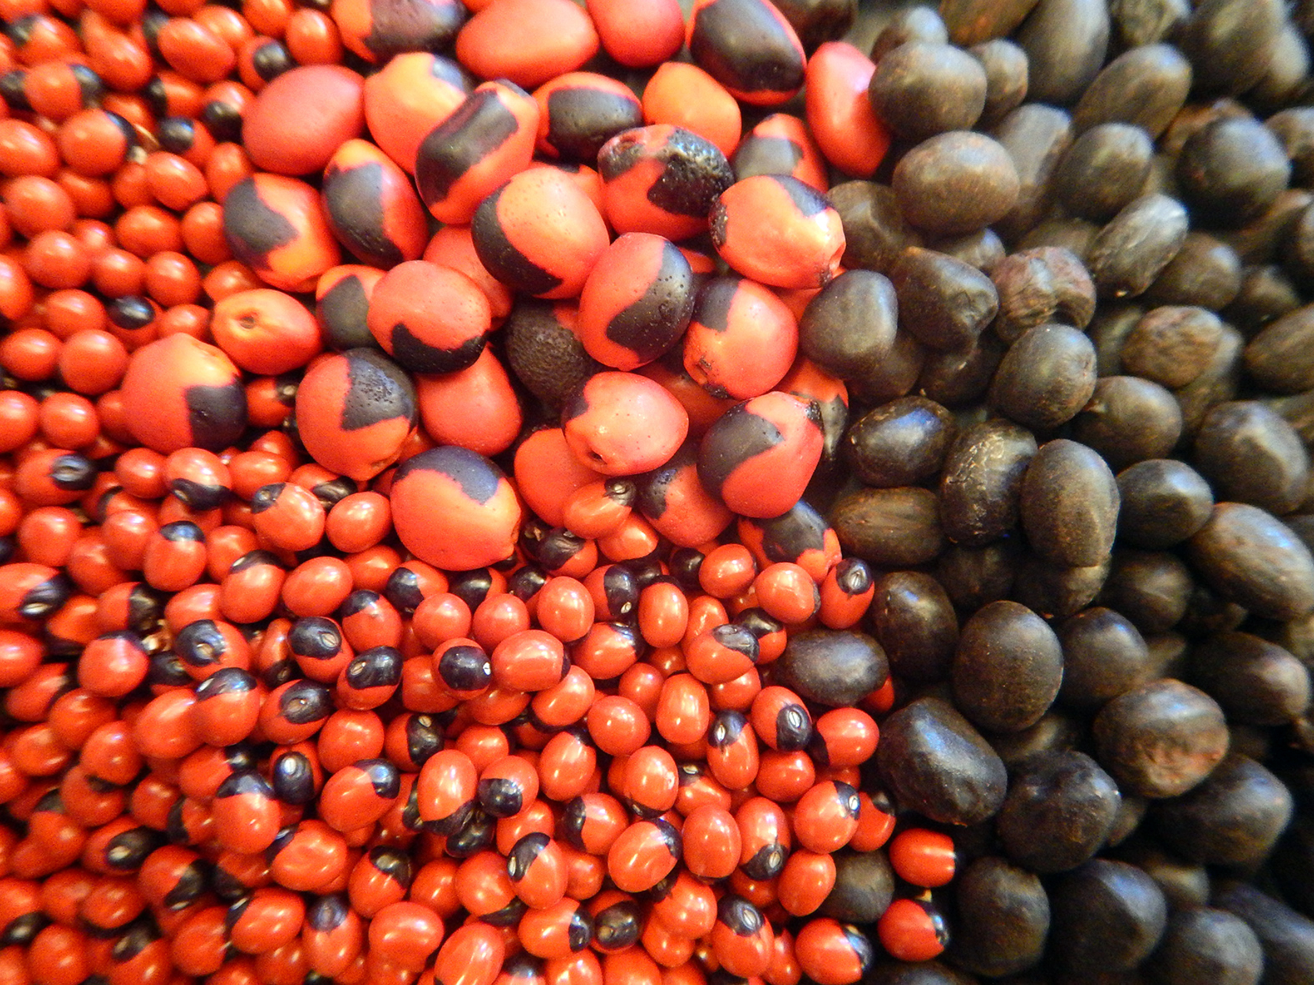
KEY MESSAGES FROM THE SUMMARY FOR POLICYMAKERS

Slide 32
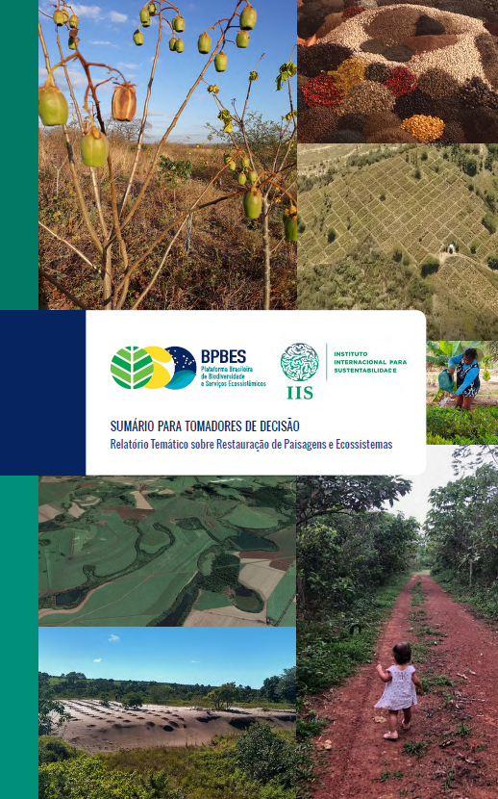
Key messages from our SPM
Brazil hosts about 42,000 plant species and 9000 vertebrate species (many endemic), and ca.130,000 invertebrate species known to science
1173 animal species and more than 2100 plant species are threatened with extinction
Brazil is home to 305 indigenous peoples, totaling almost 900,000 people speaking 274 languages
Five million Brazilians belong to traditional knowledge communities that occupy one-fourth of the national territory
“Family agriculture” produces 70% of the food consumed by the Brazilian population, and 85 out of 141 economically important cultivated species depend on pollinators

Slide 33
Key messages from our SPM
Brazil has conflicting positions: it has strong and capable institutions; but significant issues with infrastructure, slow processes, legal, social and ecological conflicts, and inefficiency in actions
Incoherent position abroad and in the homeland: contrary to the principles established in international agreements, the government is systematically dismantling its environmental policy internally

Slide 34
Key messages from our SPM
The window of opportunity to consolidate the basis for a sustainable future in Brazil is limited
It would require placing biodiversity and ecosystem services immediately at the center of the economic discussions
Brazil must ensure enforcement of existing laws through regulatory mechanisms and incentives, in line with the global sustainability commitments made by other countries

Slide 35
Key messages from our SPM
Investing in the conservation and restoration of biodiversity shows potential for new social and economic development, as a source of job and income creation, and a reduction in poverty and socioeconomic inequity

Slide 36
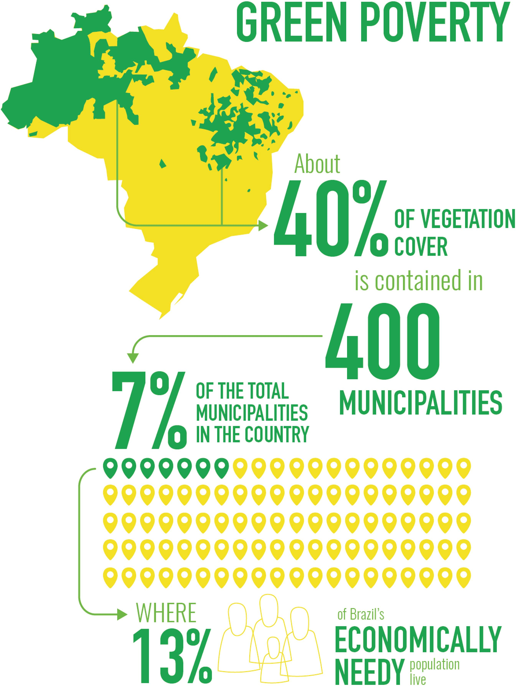
The concentrated poverty in municipalities with substantial native vegetation cover is a risk that may become a unique opportunity to reconcile conservation with human development
Income generation from conserving nature will be essential to reconciling socioeconomic prosperity with natural resource conservation
Policy to Guarantee Minimum Prices for socio biodiversity products (non-wood forest products extracted by traditional populations) is already in place

Slide 37
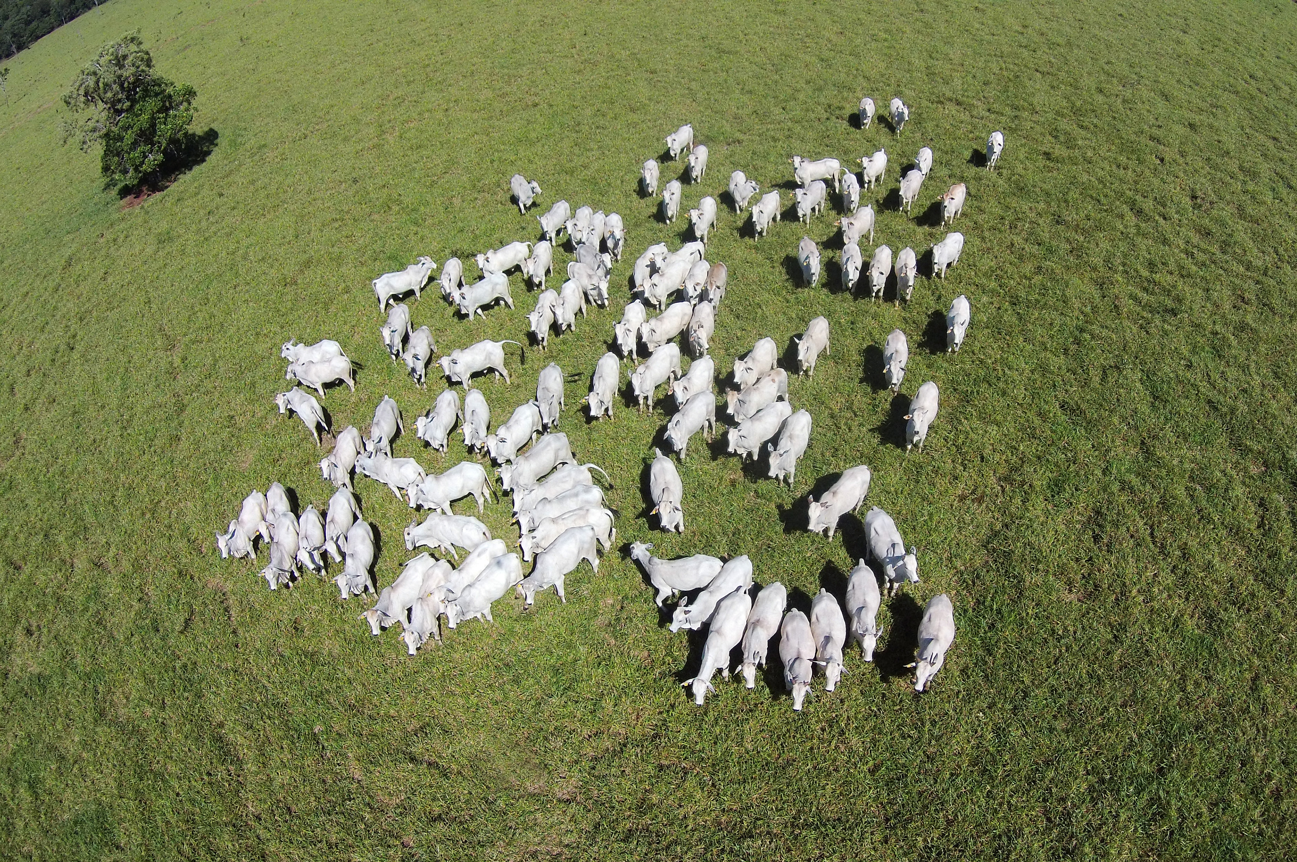
Livestock intensification
An increase from 65 to 148 kg/ha/year
Zero illegal deforestation
Free up to 30 million ha
Achieve the Paris agreement
Achieve national targets for food production

Slide 38
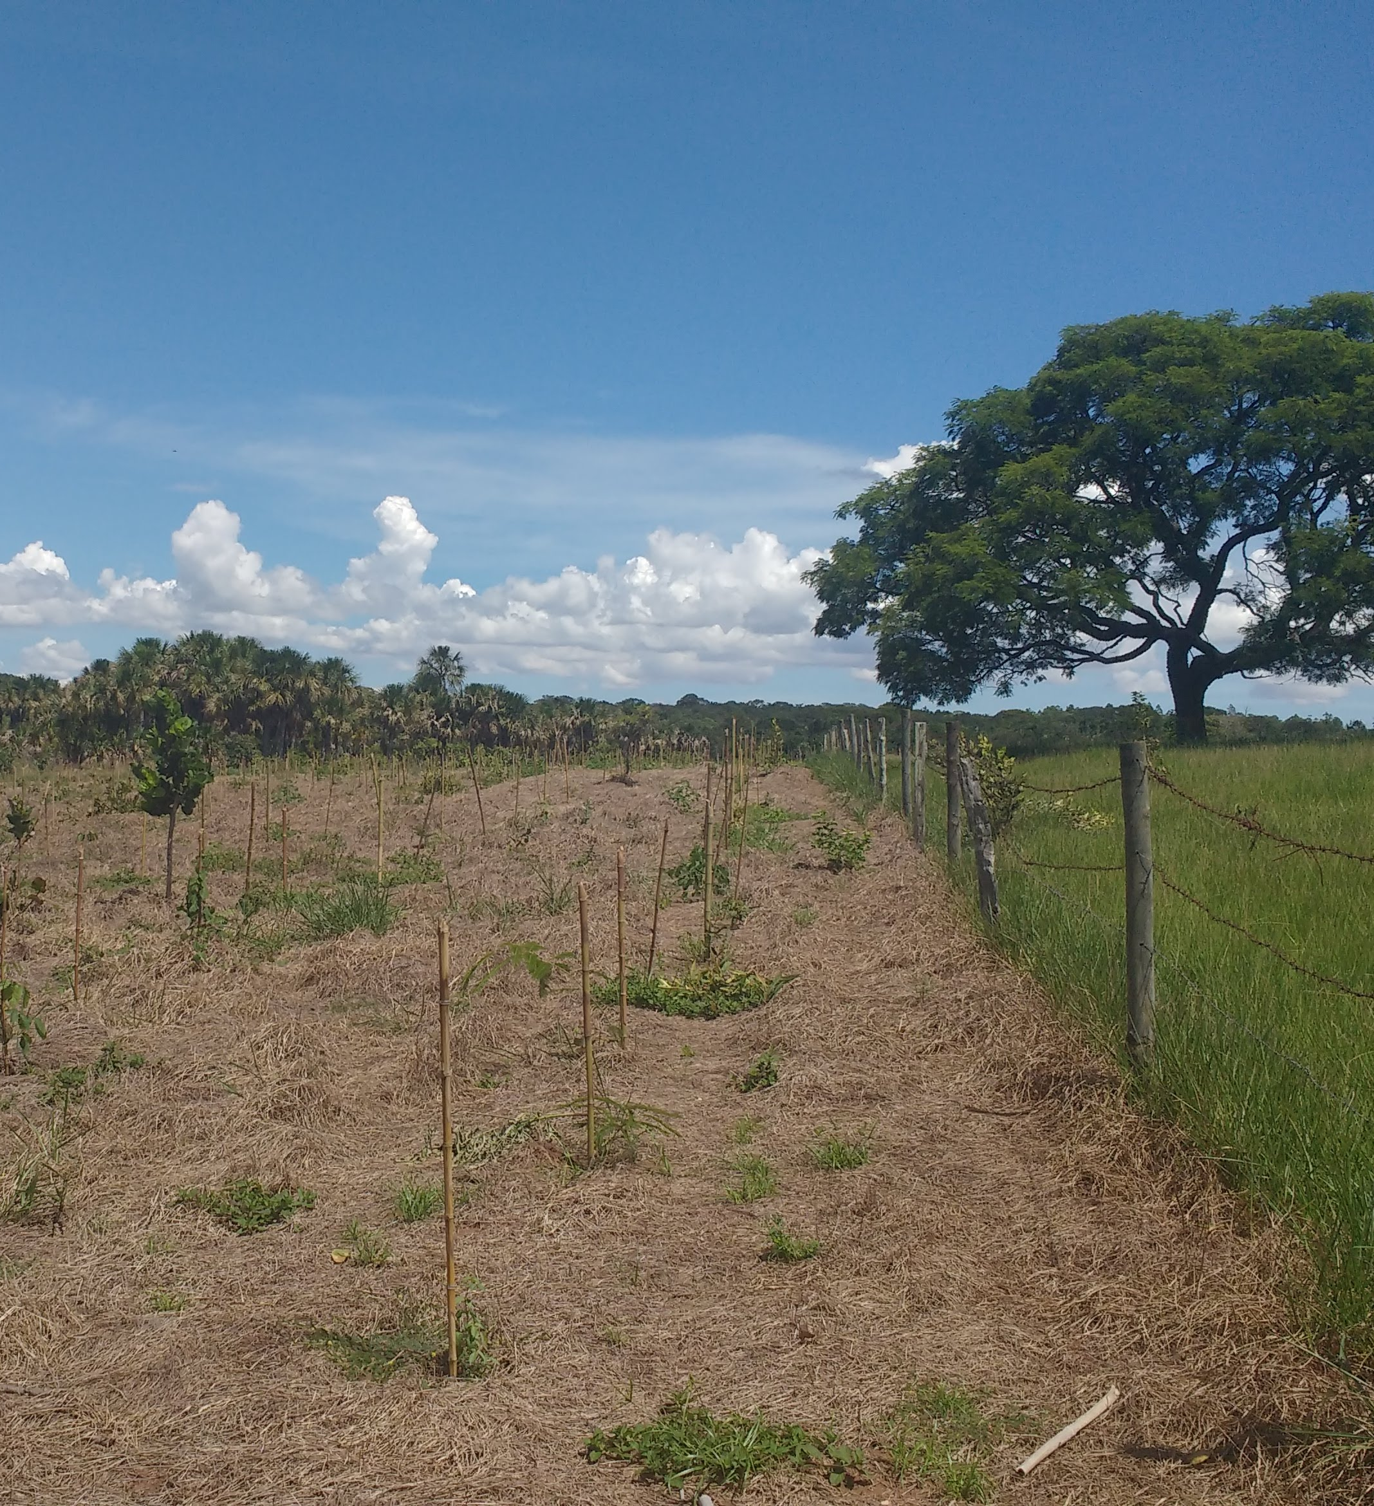
Creating competing interests
Amazon forest = US$875/ha/year
In the Cerrado = US$575/ha/year
Conversion to soy = US$300/ha/year
Conversion to pasture = US$25/year
Pollinators lead to a 90% increase in production
40% of pharmaceuticals come from biodiversity

Slide 39
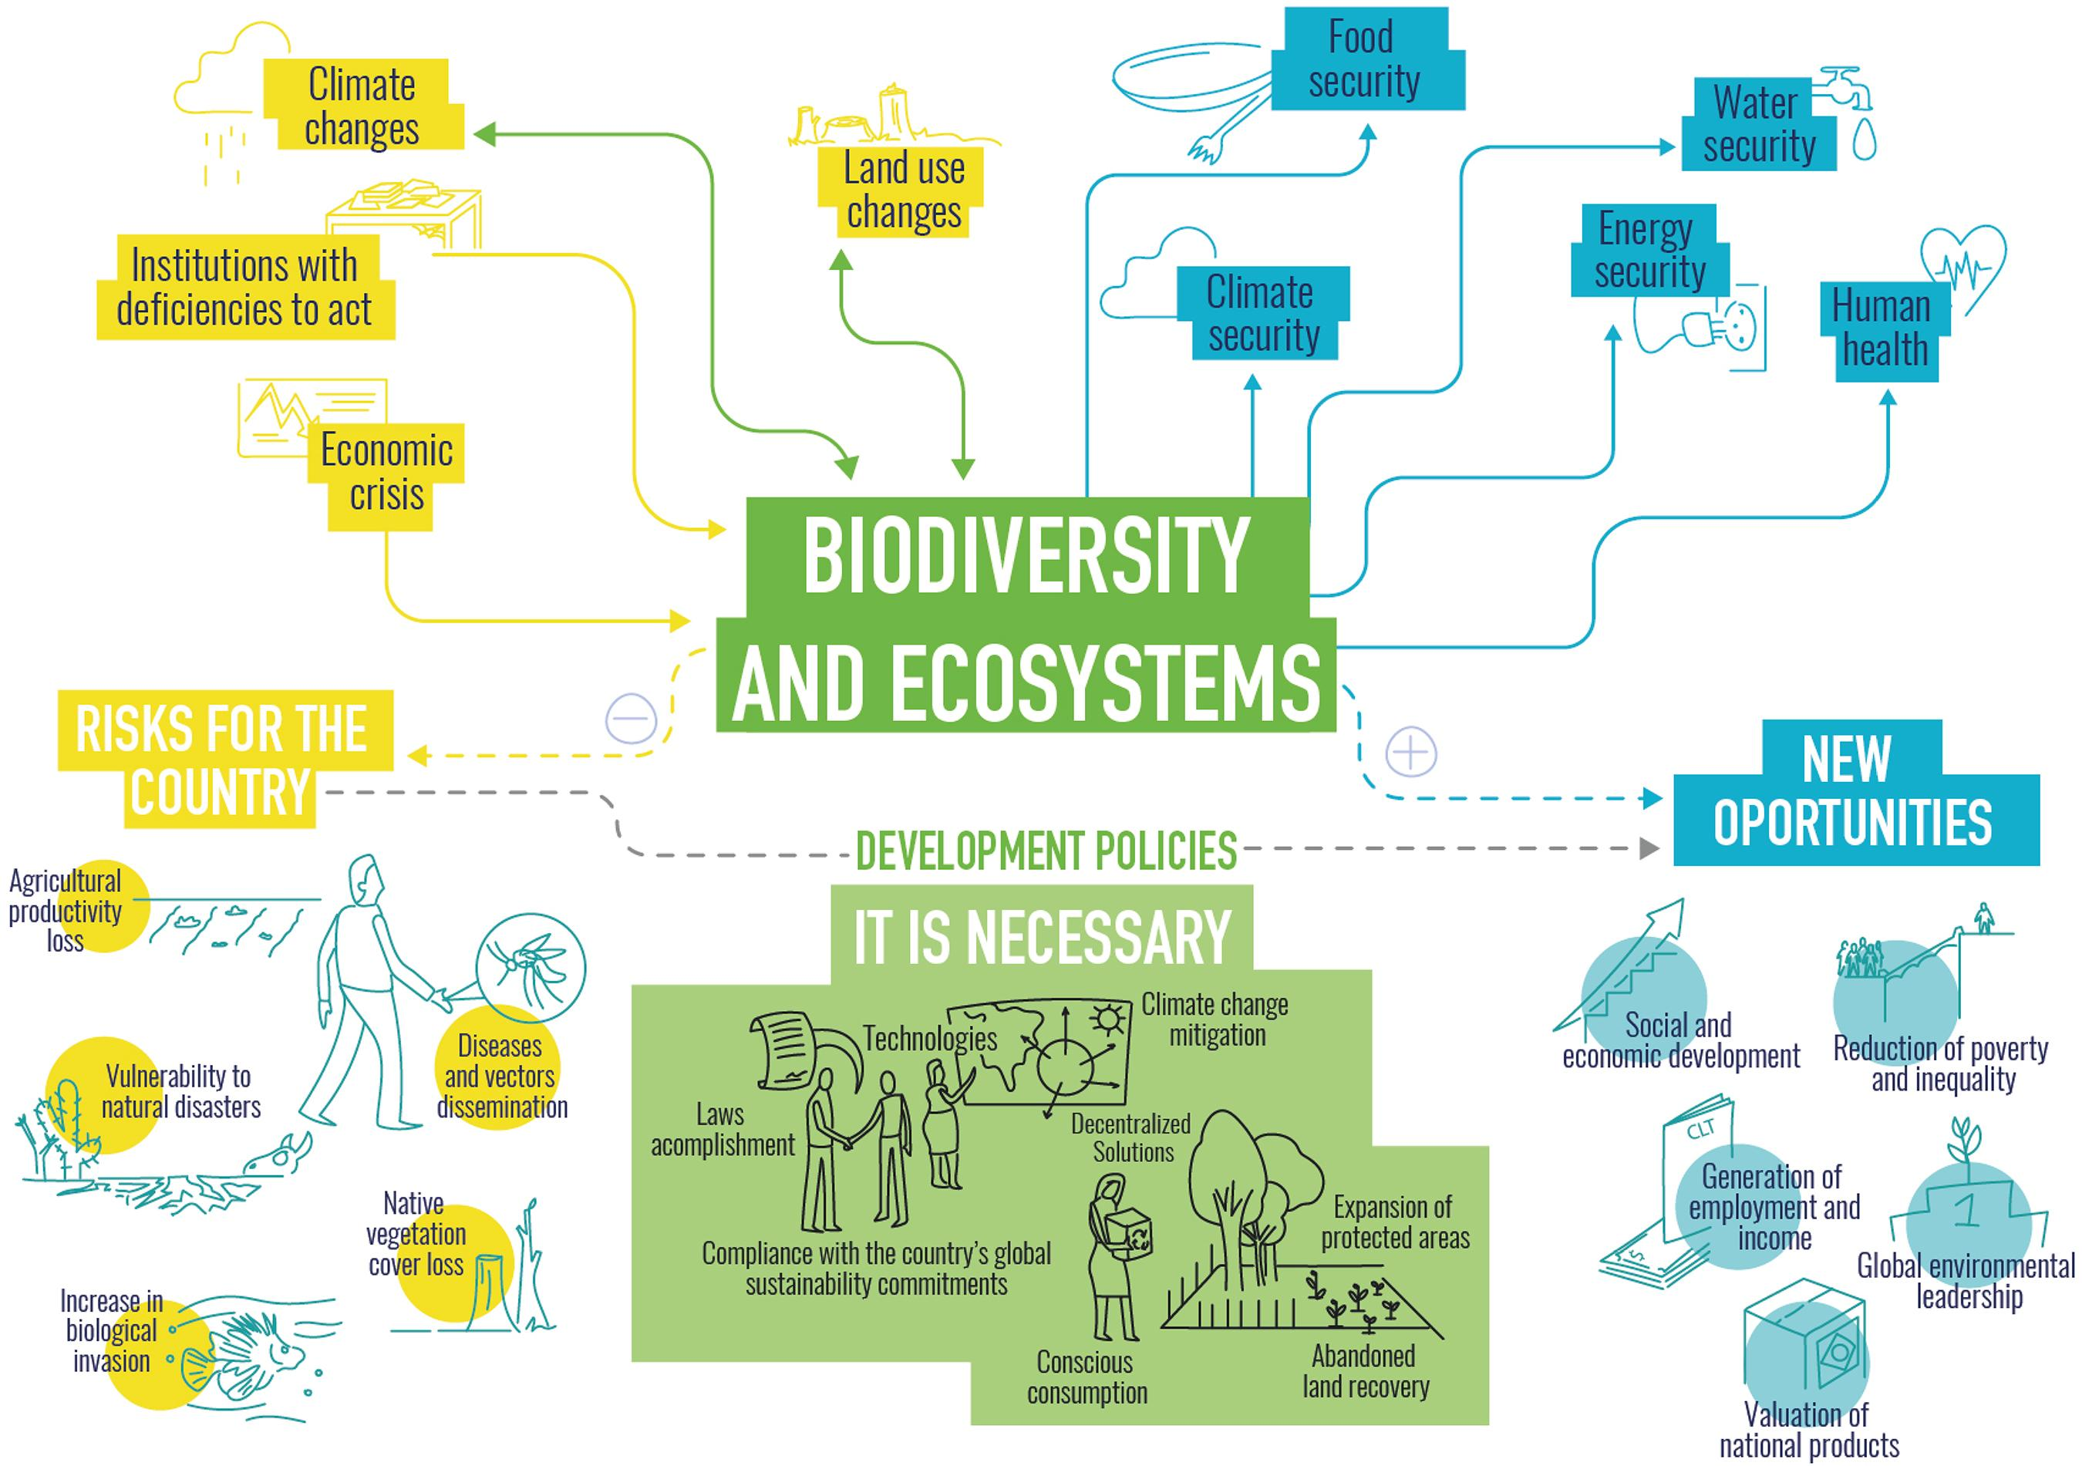
Notes:
The loss of biodiversity caused by the conversion of native ecosystems and the unsustainable use of natural resources threatens essential processes for human well-being. The growing systemic crisis (economic, climatic, hydrological, food and migratory) in Brazil is contrasted by the country's vast range of natural resources and opportunities to address these demands. Its enormous natural capital provides the conditions needed to transform the conservation and sustainable use of environmental assets into development opportunities capable of dealing with future climate changes, while promoting socioeconomic prosperity. This unusual combination results from the fact that the high potential for economic production (present and future) depends on maintaining biodiversity resources and associated ecosystem services

Slide 40
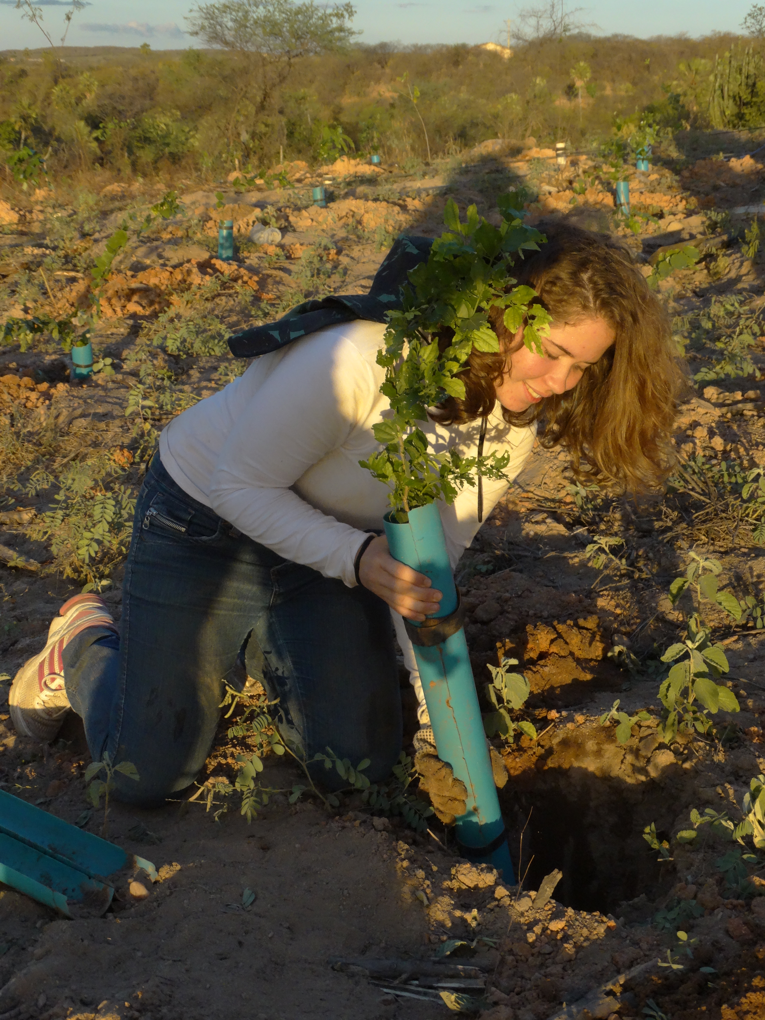
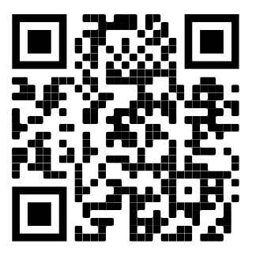
Thank you

Slide 41

Panel Discussion
@Darin Sakdatorn

Slide 42
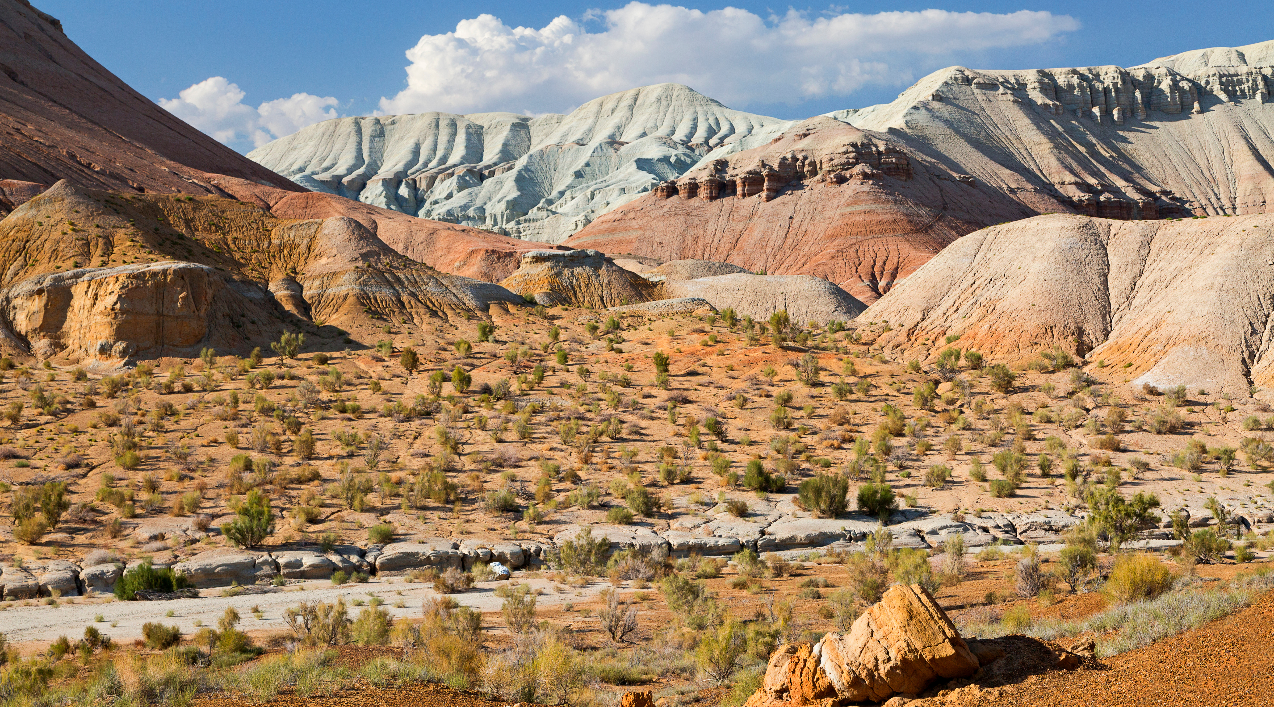

What’s next?
Webinar: Launch of the National Biodiversity Platform Guidebook by UFZ
July 2022 – Time TBC
Aktau Mountains – by MehmetOZB on AdobeStock

Slide 43


Thank you!
@Andras
www.unep-wcmc.org
Facebook: @unepwcmc
Twitter: @unepwcmc
LinkedIn: UNEP-WCMC
Youtube: UNEP-WCMC Communications

