Slide 1
Business & biodiversity global developments & perspectives
SHENA RANGEL GARCIA DEPUTY HEAD OF PROGRAMME, NATURE ECONOMY
UNEP-WCMC
Notes:
Transition slide template

Slide 2
Business and Biodiversity: Global Developments
Dr Shaenandhoa García Rangel
Nature Economy Impact Area
UNEP-WCMC

Slide 3
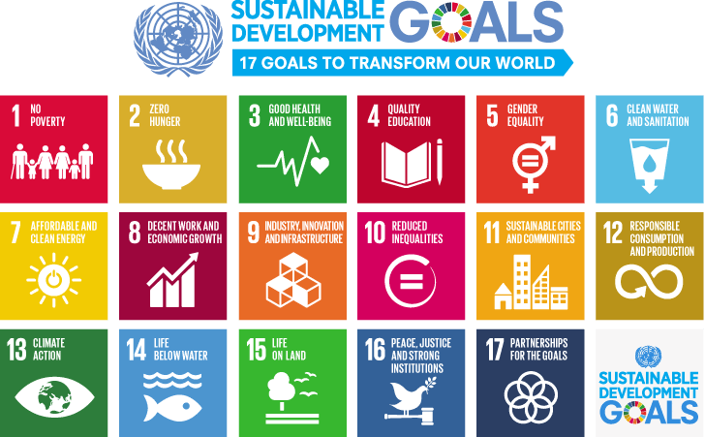
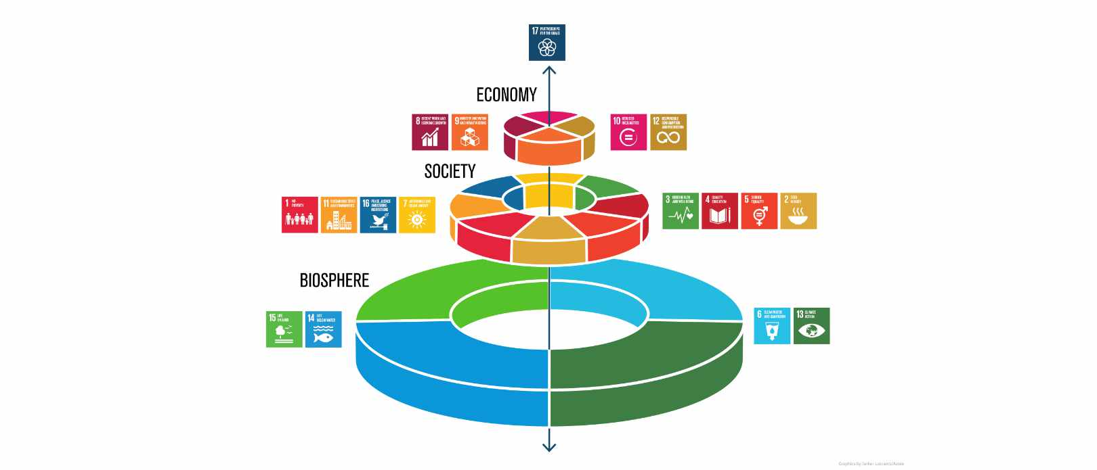
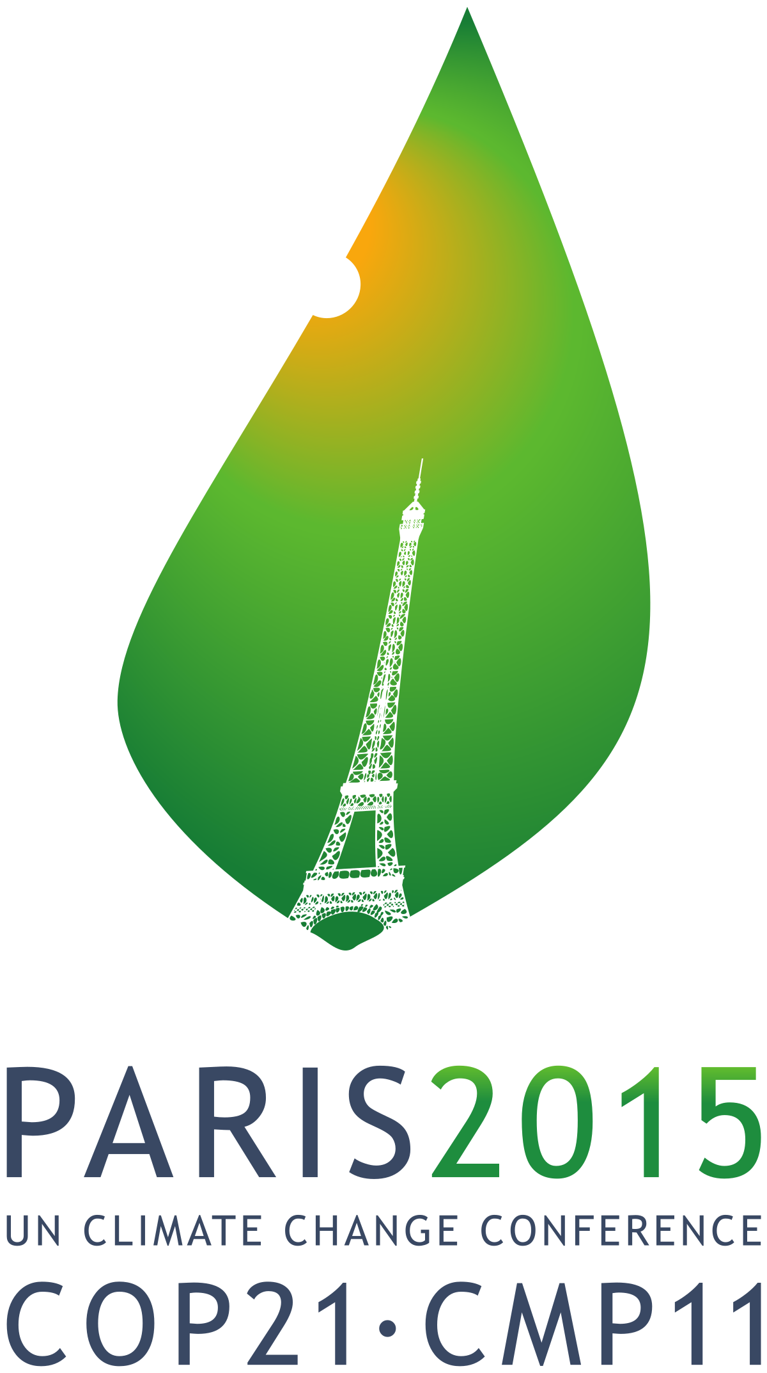
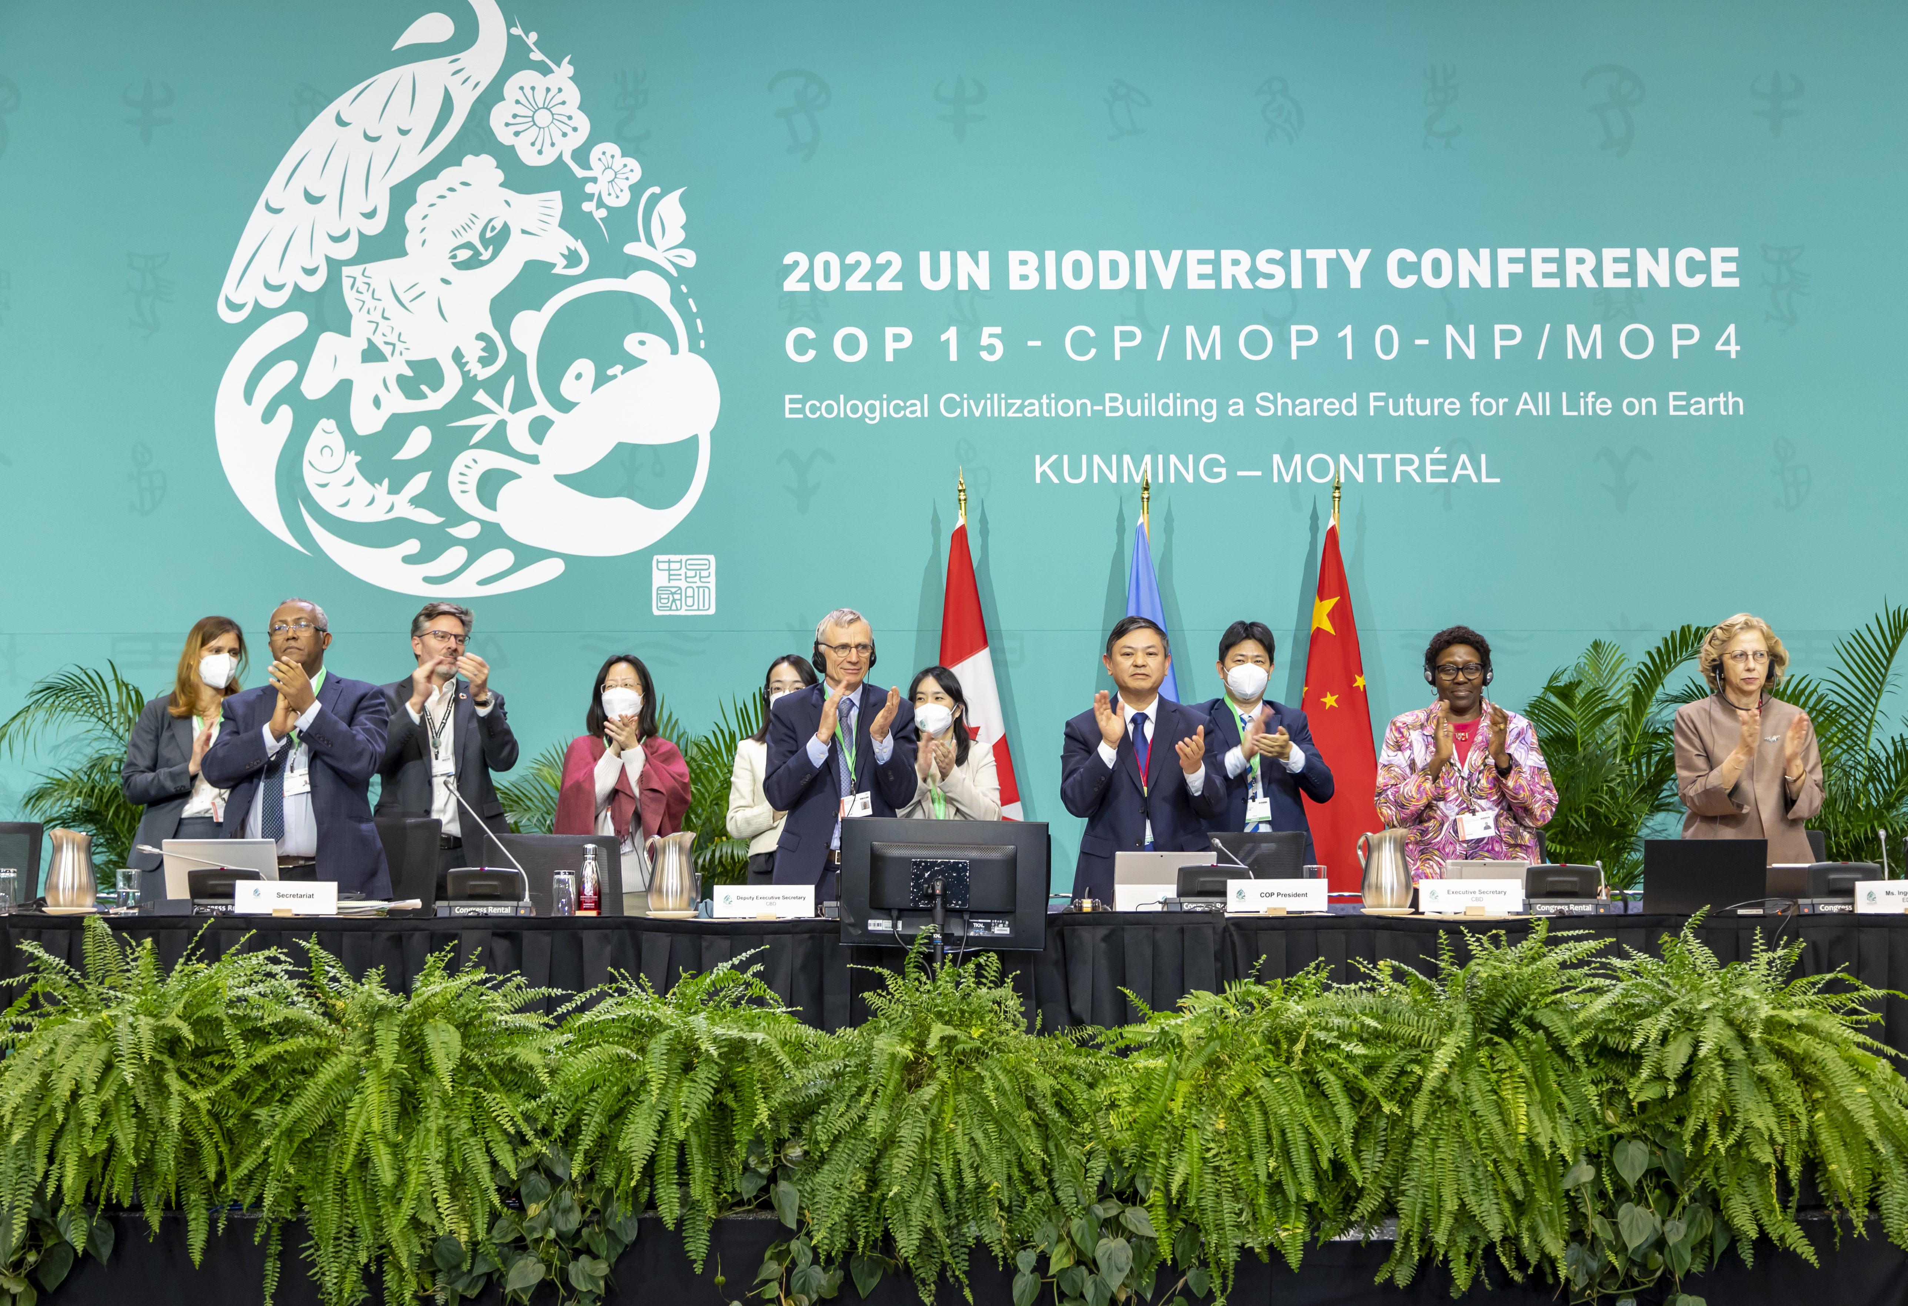
Including businesses and financial institutions
Azote for Stockholm Resilience Centre
Notes:
Whole of society approach

Slide 4
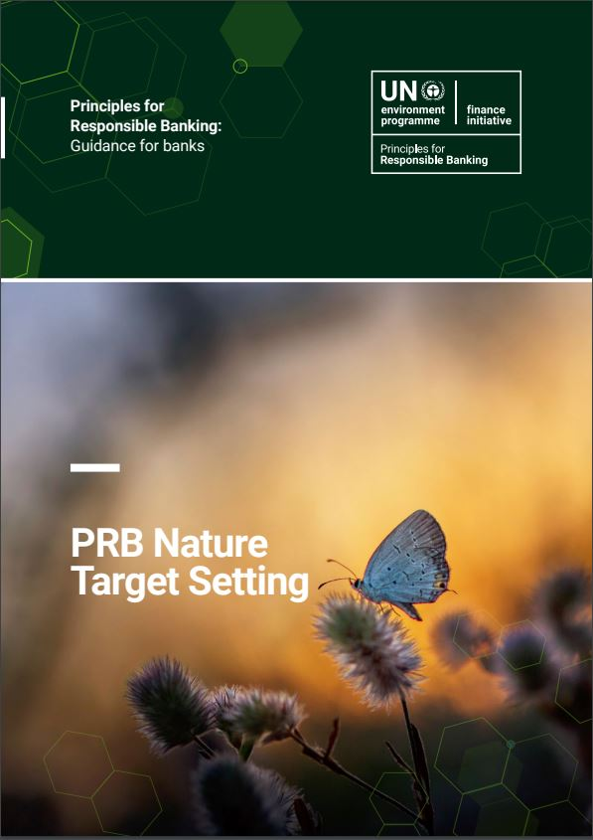
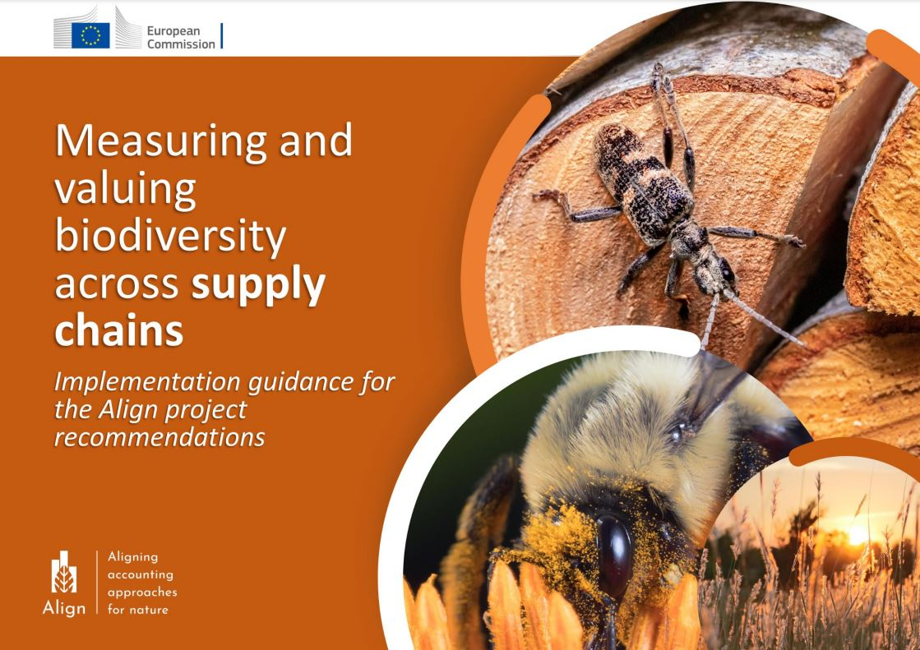
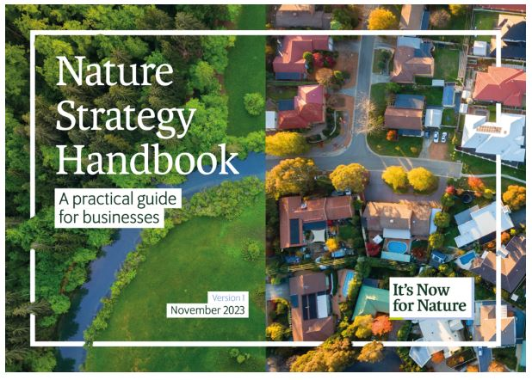
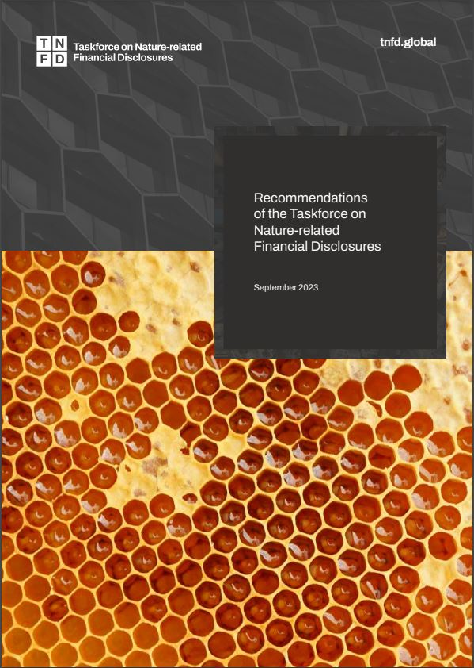
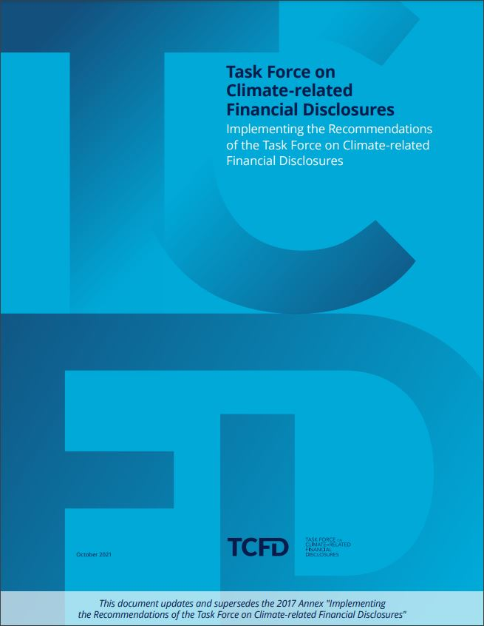
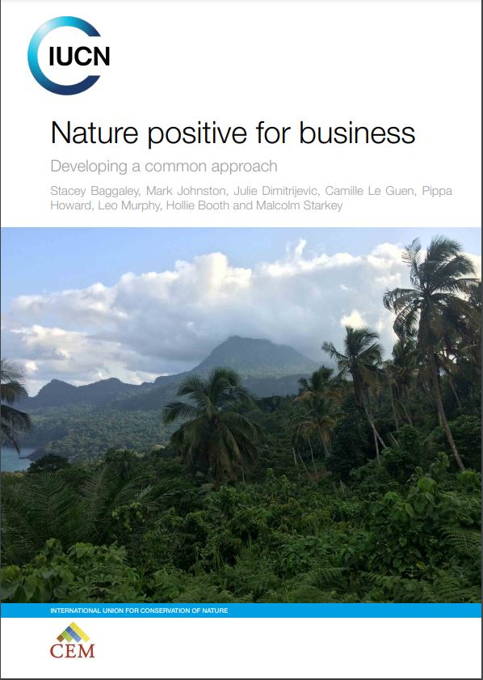
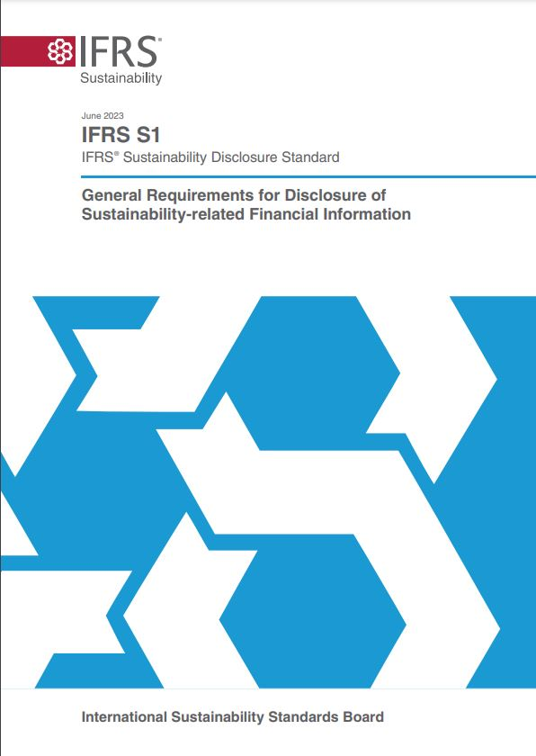
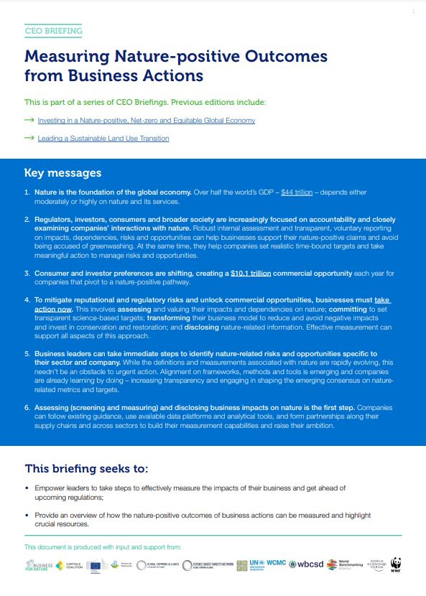
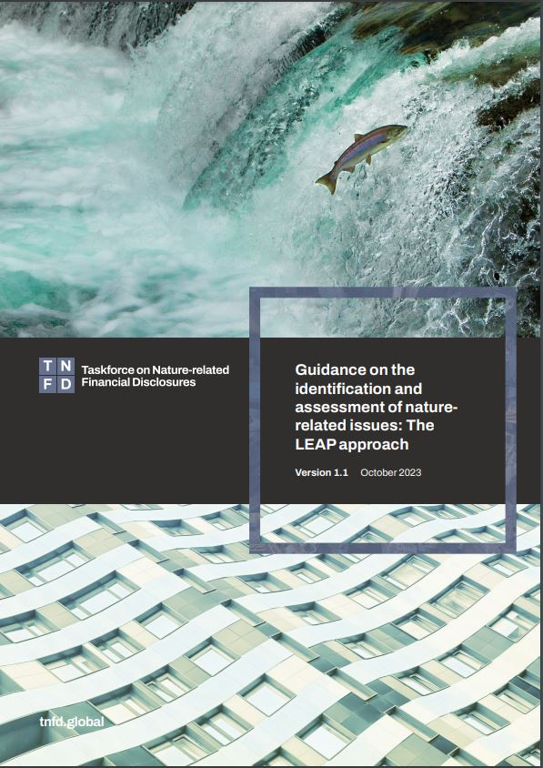
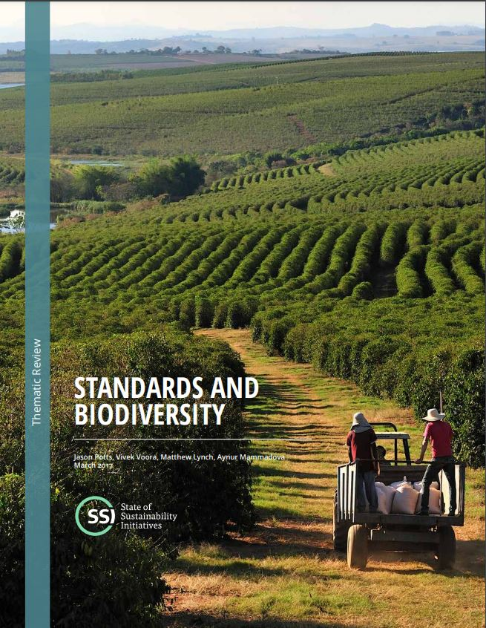
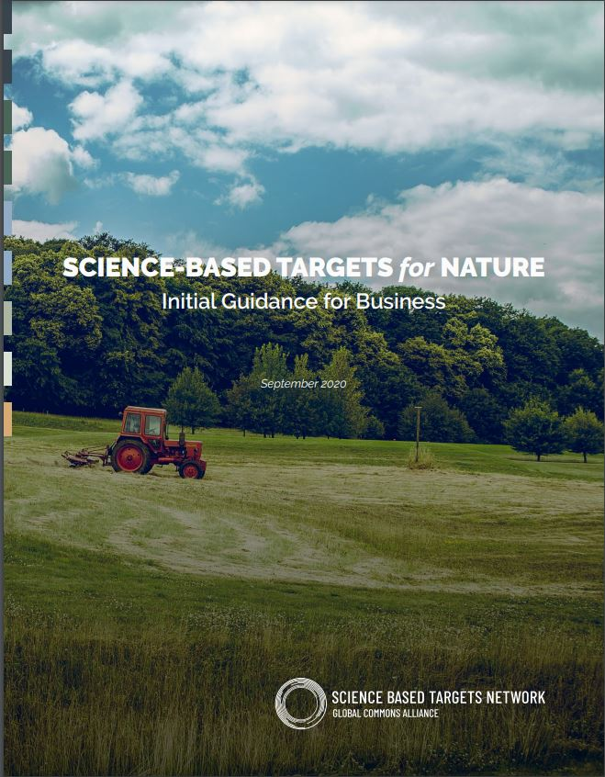
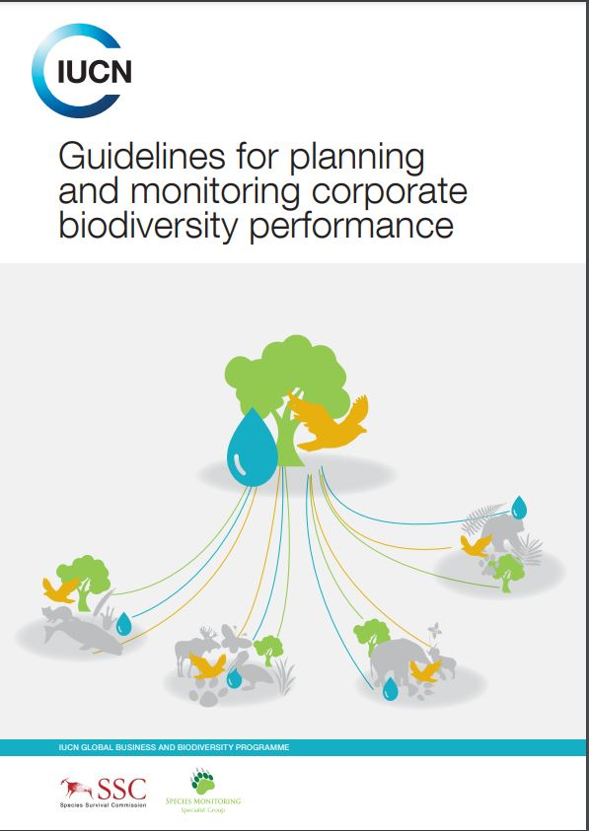
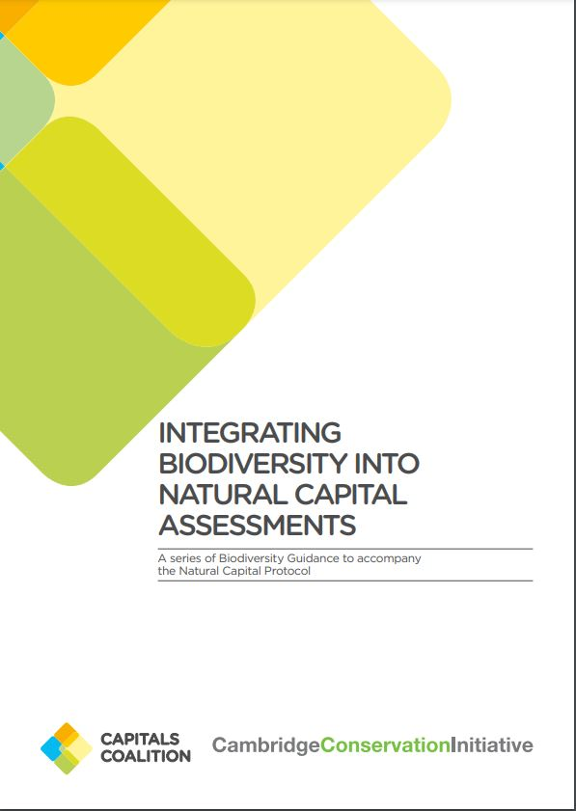
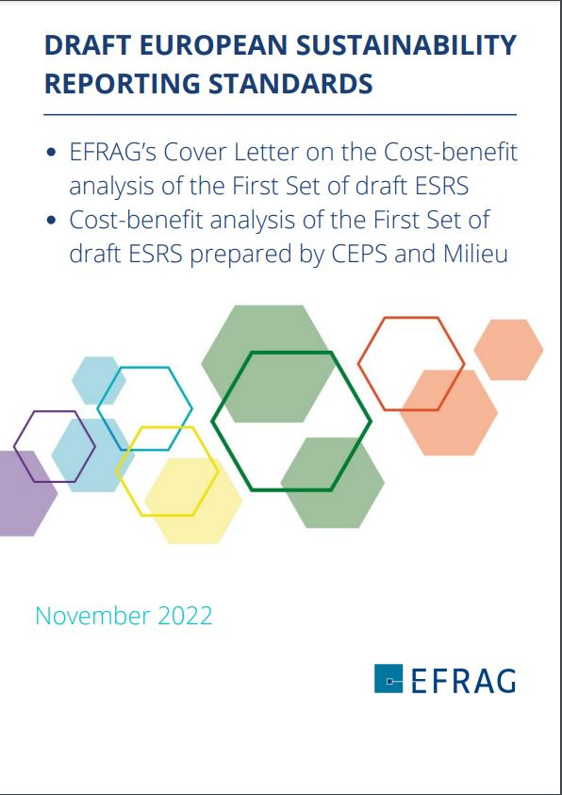
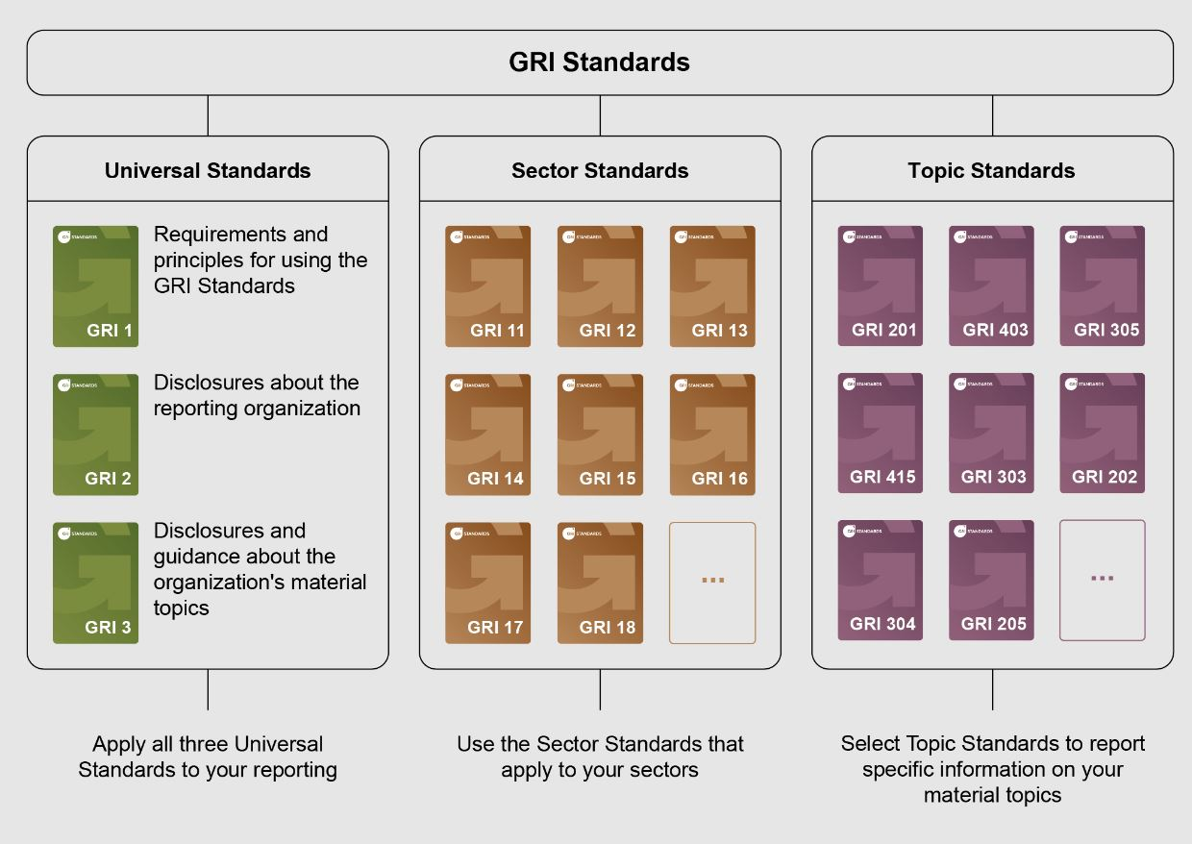

Slide 5
The Backdrop

Slide 6
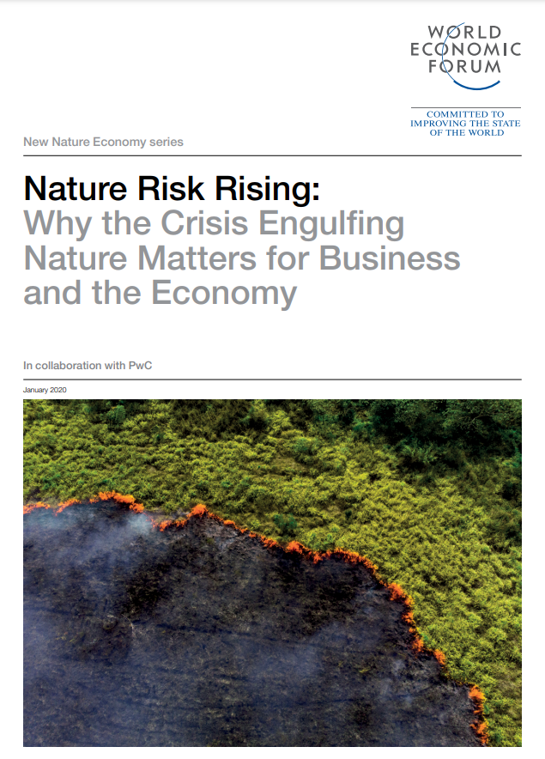
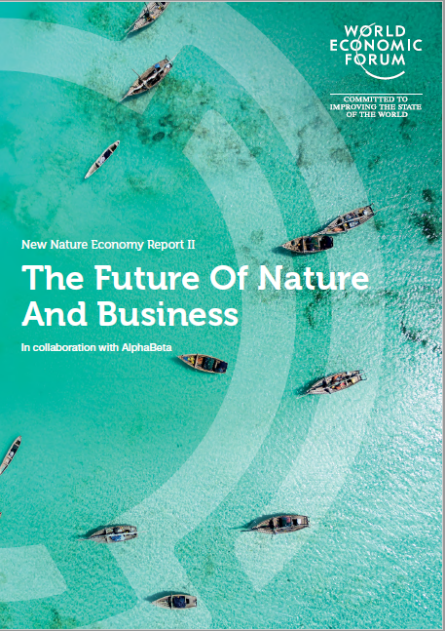
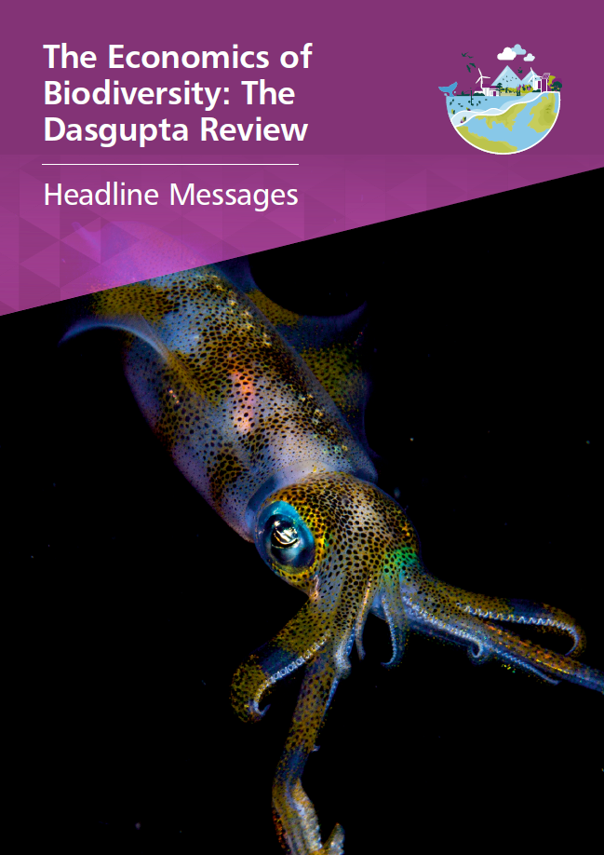

Slide 7
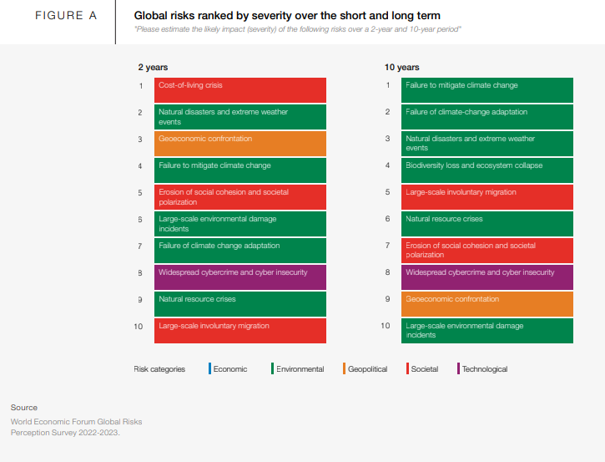
50%
Top
6
Environmental
risks
Threats to humanity
GDP potentially at risk
The Future of Nature and Business (2020)
Notes:
“Biodiversity loss and ecosystem collapse” is viewed as one of the fastest deteriorating global risks over the next decade, and all six environmental risks feature in the top 10 risks over the next 10 years. 5 environmental risks within the coming 2 years
This translates in potential disruption for businesses
Globally, $44 Trillion of economic value generation are at risk from nature loss (50% of Global GDP)

Slide 8
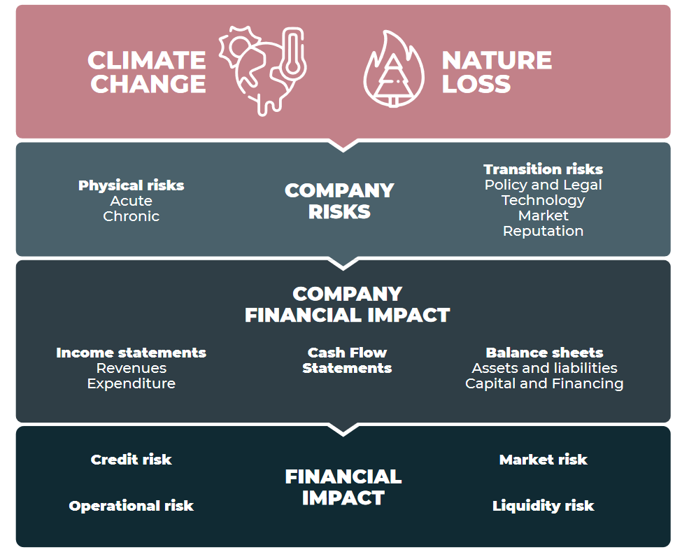
Finance for Biodiversity Initiative (2021)
Notes:
Taken together, climate change and nature loss can present a number of risks for companies which in turn can translate into financial impact reflected in income statements, cash flow and balance sheets. Experienced on a broad scale this can have knock-on implications for the financial system affecting credit ratings, liquidity and markets.

Slide 9
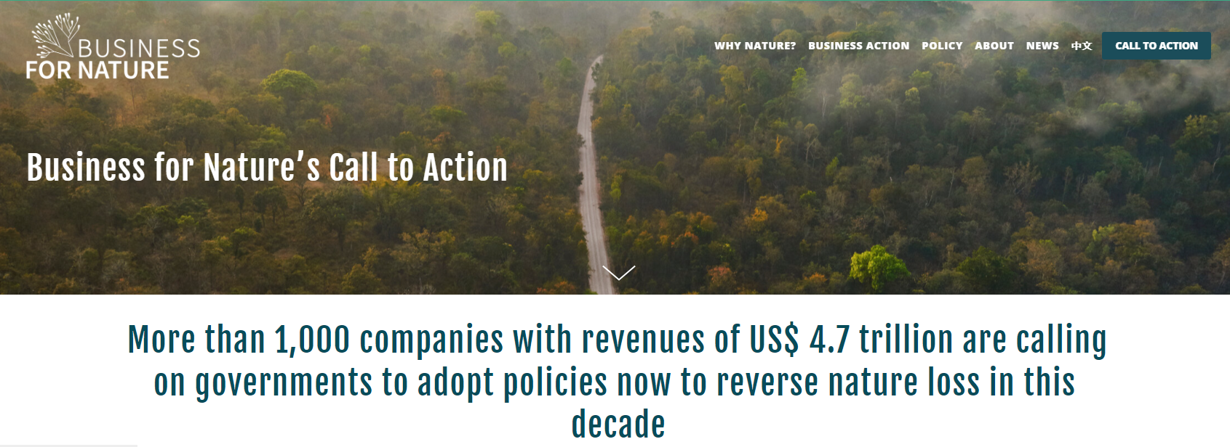
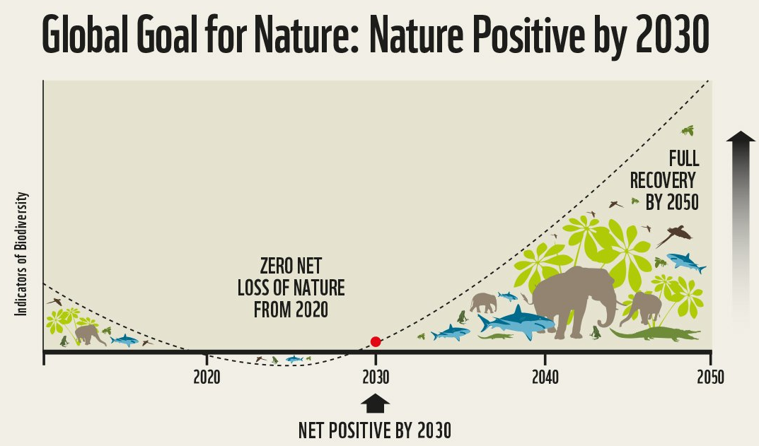
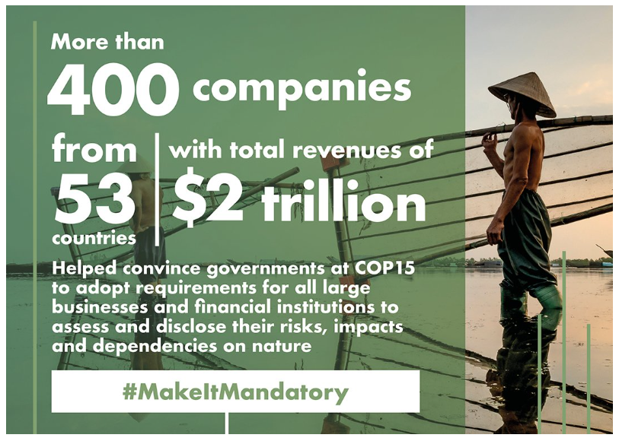
www.naturepositive.org (2023), Business for Nature (2023)
Notes:
Greatest representation of businesses in a CBD COP15.
In 2020 a wide-ranging group of NGOs and business organizations put forward a global goal for nature-positive as a clear call to action for more ambition and an overarching goal that could be integrated with other climate and development goals. The Global Goal for Nature (Locke et al, 2020) outlines three temporal objectives, set against a baseline of 2020, to:
Achieve zero net loss of nature by 2020
Be nature net-positive by 2030
Have a full recovery of nature by 2050

Slide 10
Teck: “Goal to become a nature positive mining company by 2030 … including through conserving or rehabilitating at least three hectares for every one hectare affected by its mining activities”
Unilever: “working towards a nature-positive future, where forests are protected and restored, agricultural systems are regenerated, water systems are preserved, and smallholder farmers are empowered.”
BHP: “create nature-positive outcomes by having at least 30% of land and water…under conservation, restoration or regenerative practices”
Holcim: “nature strategy with measureable 2030 targets to restore and preserve biodiversity and water”
GSK: “Action on nature is important for human health, climate change and business success”.
Business for Nature (2023)
Notes:
Against this backdrop we are starting to see the number of business commitments towards nature growing in number and in ambition. We are starting to see an increasing number of business are adopting best practices such as applying the mitigation hierarchy. However, these targets and practices alone will not lead to the transformative changes needed to deliver nature positive change, which requires a transformation across value and supply chains. Some companies are considering their approaches in line with broader global goals and efforts across the broader landscape.
Pressure on businesses to take action and make science-based commitments is growing. Action towards nature should be underpinned by actions to address impacts caused by project activities, but it is increasingly recognised that businesses need to go beyond this and look for opportunities for positive action within value chains and land/sea scapes and to address historical and accumulated losses.

Slide 11
Shifting
95% of millennials and 85% of all investors are now interested in sustainable investing strategies (Morgan Stanley, 2020)
Institutions with over $14 trillion in assets have committed to divesting from oil & gas in a movement often led by students (Fossil Free 2021)
36% of employees favour companies that focus on social equity and environmental protection (Mercer, Global Talent Trends, 2020-2021)
Stakeholder interests
Notes:
Against this backdrop we are starting to see the number of business commitments towards nature growing in number and in ambition.
Some companies are considering their approaches in line with broader global goals and efforts across the broader landscape. Others are linking their commitment towards project impacts and aiming towards net positive impact, where overall losses as a result of project activities are exceeded by the gains made for biodiversity.
Pressure on businesses to take action and make science-based commitments is growing. Action towards nature should be underpinned by actions to address impacts caused by project activities, but it is increasingly recognised that businesses need to go beyond this and look for opportunities for positive action within value chains and land/sea scapes and to address historical and accumulated losses.

Slide 12
What is the role of businesses and financial institutions?

Slide 13
Impacts
Dependencies
Risks
Opportunities
Understand
Understand
Manage
Identify and implement
Baggaley et al. (2023)
Notes:
Businesses need to understand their impacts and dependencies on nature, manage their nature-related risks and embed the value of nature into their decision making to identify and implement opportunities that contribute towards the nature positive global goal.
Achieving nature positive requires collective action across sectors, value chains and landscapes. While the most ambitious actions by single companies cannot deliver nature positive if implemented in isolation, individual businesses can

Slide 14
www.naturepositive.org (2023), Azote for Stockholm Resilience Centre
Notes:
Nature positive is a global societal goal to halt and reverse the loss of nature for the benefit of people and the planet. Achieving this will require action by governments, businesses, and financial institutions.
A clear call to action for more ambition and an overarching goal that could be integrated with other climate and development goals. The Global Goal for Nature (Locke et al, 2020) outlines three temporal objectives, set against a baseline of 2020, to:
Achieve zero net loss of nature by 2020
Be nature net-positive by 2030
Have a full recovery of nature by 2050
The term “nature positive” was not included within the final text of the Kunming-Montreal Global Biodiversity Framework. However, there is alignment between the language and terminology used in definitions of nature positive and the mission and vision of the KMGBF. The 2030 mission speaks to the need to “halt and reverse biodiversity loss to put nature on a path to recovery”. In addition, the KMGBF goals and many of the nature positive definitions (as highlighted in section 2.1) include similar language and intent. The goals and targets within the KMGBF seek to address pressures on biodiversity, increase efforts towards protection, conservation, and restoration, and ensure sustainable use of biodiversity for the benefit of people and the planet. This increase in biodiversity globally is fundamental to achievement of a global goal for nature positive.
A nature positive goal recognises that the Sustainable Development Goals can only be realised if the biosphere related goals are met (Figure 2). Recognition of these interconnections and synergies between global goals will enable coordinated action towards a nature positive, net-zero and equitable wor

Slide 15
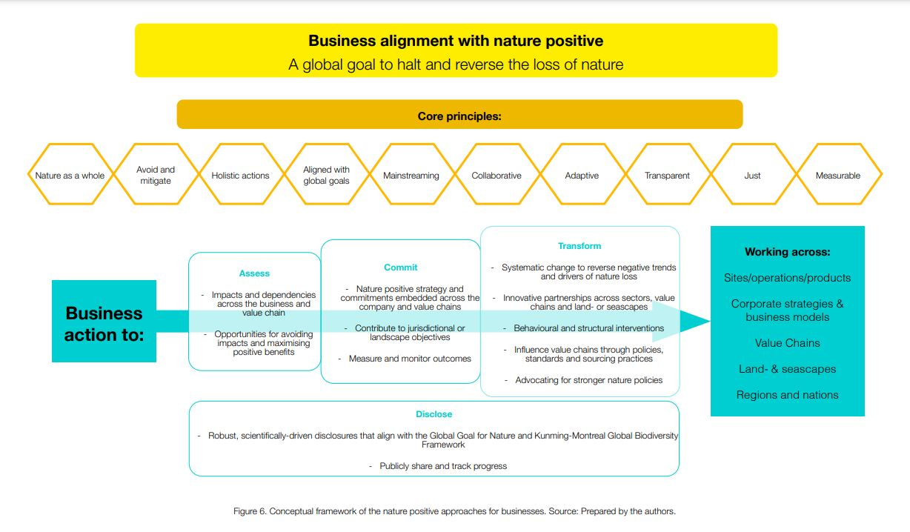
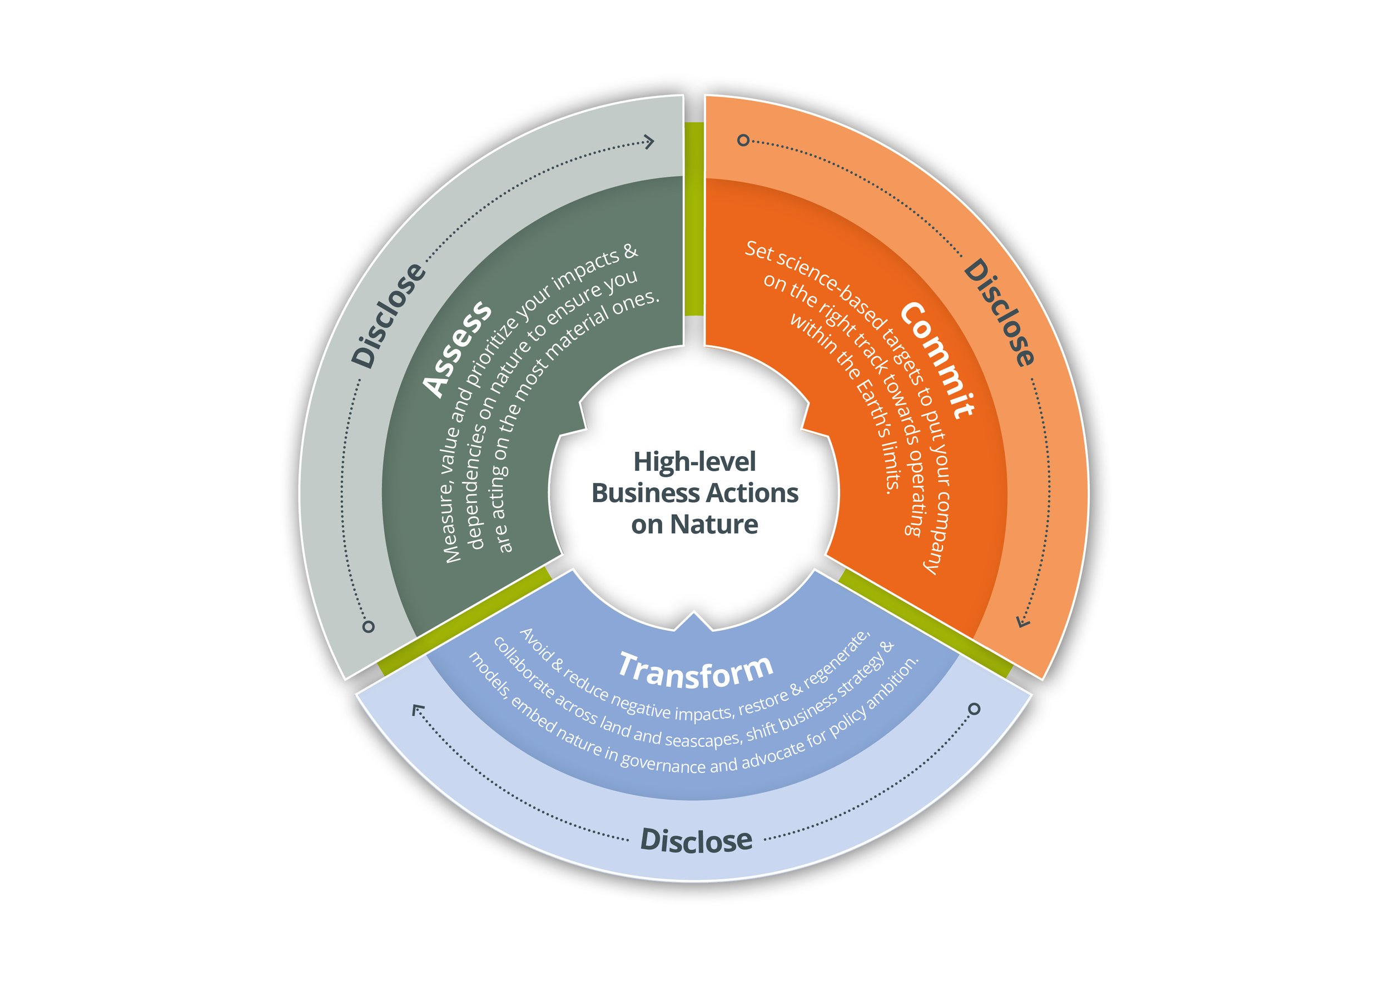
Baggaley et al. (2023), https://www.businessfornature.org/
Notes:
Just this week, IUCN published a conceptual framework for business action that could be useful to conceptualise your approach to businesses and financial institutions.
The high-level business actions for nature (Business for Nature, 2022), provide a framework for key actions businesses can take towards nature positive (Figure 5). This framework was developed in collaboration with leading organisations with a view to achieve alignment and build on existing guidance and initiatives (including from the Science Based Targets Network, Taskforce on Nature-related Financial Disclosures, World Business Council for Sustainable Development (WBCSD) nature positive building blocks, and Natural Capital Protocol). These steps can help business to structure their approach and guide their activities and actions. This paper outlines considerations and potential areas of action across the assess, commit, transform and disclosure framework to guide business in developing their thinking and strategies to contribute to nature positive. This necessitates a suite of action by business, enabled by ambitious commitments and shifts in business models and purpose at the corporate level, and implemented across value chains, sites, and landscapes.

Slide 16
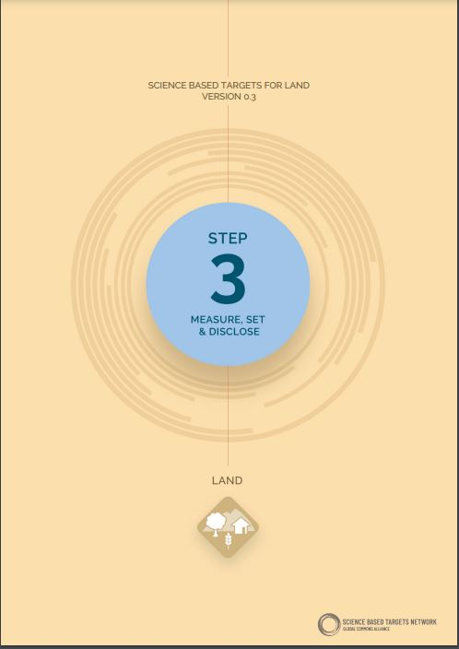
SBTN, Land (2023), TNFD (2023)
Notes:
Here are just three of the guidance that you would probably most here about in relation to brining biodiversity to the heart of decision-making within the private sector. I mainly focused in 2023, The LEAP approach from the Task-Force on nature-related finance disclosures helps businesses and financial institutions identify and assess their nature-related issues (impact, dependencies, risks and opportunities) to support disclosure and action. Framework for companies and Fis to identify, assess, manage and, where appropriate, disclose nature-related issues.
This version of SBTN’s Step 3 Land guidance will allow a selected group of companies to pilot Science Based Targets for Land and to align their commitments to nature with the necessary speed and scale of action as determined by science.
Within Land systems the targets are used to operationalize and define a consistent path for companies that will align their commitments and actions with what nature needs: • Target 1: No Conversion of Natural Ecosystems • Target 2: Land Footprint Reduction Reduces • Target 3: Landscape Engagement

Slide 17
IPBES
Business and Biodiversity
Assessment
Chapter 1 – Setting the scene
Chapter 2 – How does business depend on biodiversity?
Chapter 3 – How does business impact in biodiversity?
Chapter 4 – Approaches for measurement of business dependencies and impacts on biodiveristy
Chapter 5 – Businesses as key actors of change: options for action by business
Chapter 6 – Creating an enabling environment for business: options for actions by governement, the financial sector and civil society
To be presented at plenary in 2025
Notes:
will strengthen the knowledge base to support efforts by business to achieve the 2050 Vision for Biodiversity and the objectives of the Convention on Biological Diversity,
The assessment will categorize the dependencies and impacts of business and financial institutions on biodiversity and nature’s contributions to people, which incorporates ecosystem services and other analogous concepts, including in relation to indigenous peoples and local communities. It will assess methods for measuring direct dependencies and impacts and, where appropriate, indirect dependencies and impacts, and will assess options for actions by businesses and by others, including Governments, the financial sector, indigenous peoples and local communities, and civil society, that interact with business.

Slide 18
Where do NEAs connect with businesses and financial institutions?

Slide 19
Where do NEAs connect with businesses and financial institutions?

Slide 20
Complex landscape
Potential lack of unified approach
Myriad of organisations and initiatives involved – credibility
Sparse regulation – varied voluntary approaches
Disconnect from biodiversity policy structures and actors
Patchy involvement as stakeholders
Pressure on small businesses
Biodiversity of multidimensional
Data is available at global level, sparse at the nationally
Key challenges
Notes:
Against this backdrop we are starting to see the number of business commitments towards nature growing in number and in ambition.
Some companies are considering their approaches in line with broader global goals and efforts across the broader landscape. Others are linking their commitment towards project impacts and aiming towards net positive impact, where overall losses as a result of project activities are exceeded by the gains made for biodiversity.
Pressure on businesses to take action and make science-based commitments is growing. Action towards nature should be underpinned by actions to address impacts caused by project activities, but it is increasingly recognised that businesses need to go beyond this and look for opportunities for positive action within value chains and land/sea scapes and to address historical and accumulated losses.
I hope these starts to give you an indications of the connections between the evidence-based and structures your are developing in your countries and direct linkages with business challenges

Slide 21
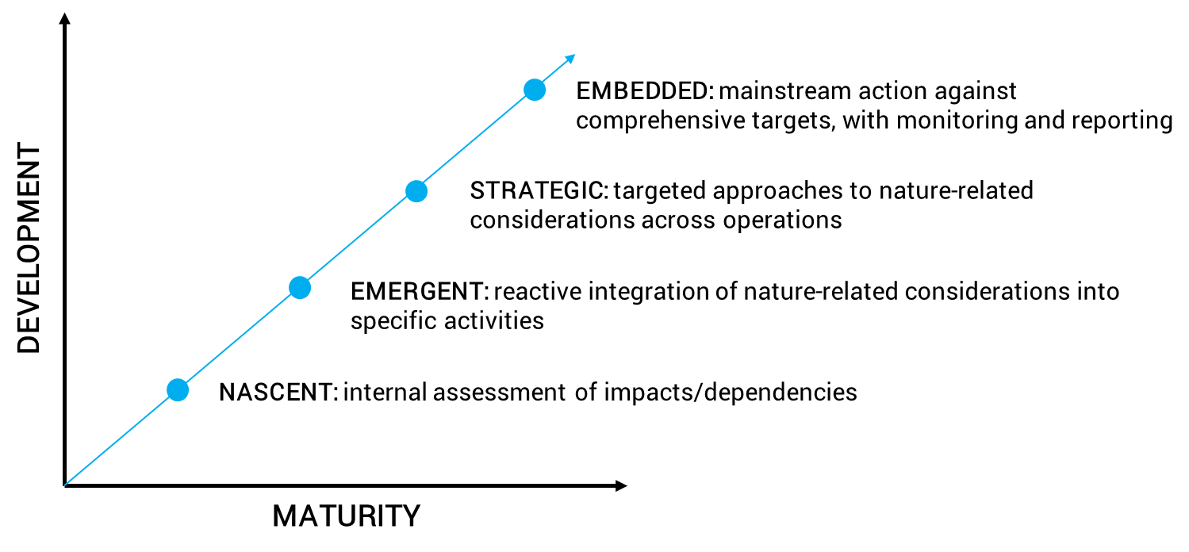
Beginning of the journey
Most companies
UN Environment Programme (2022)
Notes:
A key finding from the “Are You Ready for Nature-related Disclosure?” report was that all companies interviewed acknowledged that their business activities are facing nature-related risks, either due to their impacts and/or dependencies on nature – with reference being made to the type of risks detailed by the TNFD and many other publications, from physical risk, to regulatory, reputational and transition risks. This highlights how much ground nature-related risk as a concept, has already covered, for it to be considered across sectors and geographies.
Building on this widespread acknowledgement of risks, companies have started assessing and addressing them, but their progress on a so-called nature-related journey varies significantly, along the broad stages outlined on this graphic.
The majority of companies interviewed would be considered Nascent or Emergent, with a minority of front-runners as Strategic. It could be argued that for nature-related considerations to be fully Embedded, a company would be expected to have set comprehensive nature-related targets, with key performance indicators to monitor and report on its progress across its activities. And no companies interviewed would currently qualify as Embedded; highlighting the work yet to be done.
Another key finding has been that nature-related risk management in companies is far from systematic, with assessments, measurement and reporting practices varying significantly across companies and across topic-areas. However, all companies interviewed highlighted their ongoing search for relevant tools, data and other publicly available resources to incorporate into their risk management frameworks.
Source:
UN Environment Programme (2022). Are You Ready for Nature-related Disclosure?
https://www.unepfi.org/wordpress/wp-content/uploads/2022/04/Are-you-ready-for-nature-related-disclosure.pdf
Summary of key findings:
Most companies are beginning their journey to embed nature in operations.
Nature-related risks are not systematically or comprehensively acted upon.
Nature-related risk management is far from systematic, with a focus on mitigation of impacts in direct operations or engagement with suppliers.
Reporting and disclosure of nature-related risks is inconsistent and insufficient and lacks shared approaches.
Front runner companies are beginning to look at dependencies through the lens of nature-related opportunities.
Companies need help and are looking for opportunities to collaborate.

Slide 22
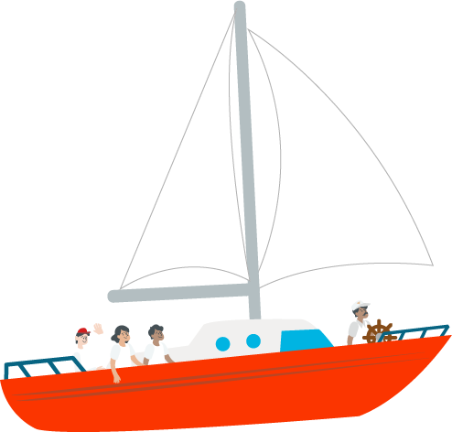
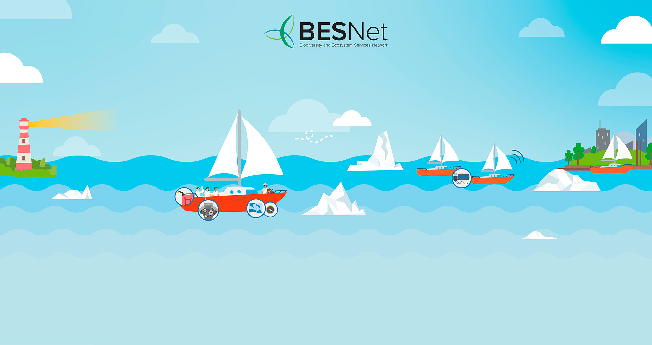
NEA as an integral part of the sailing expedition
Identification of needs
Policy-science nexus building
Baseline – Validation – Source of information
Networking & partnership
Knowledge/evidence base
Community of practice
Regulation - Guidance
Transboundary coordination and communication
Informing policy
Contributing towards commitments
Engagement with global process
Harnessing opportunities

Slide 23
Some ideas on where to start

Slide 24
Where to start?
Notes:
Climate commitments towards Net-Zero are a very good point to start as companies have already starting developing their strategies and disclousing actions for a few years now

Slide 25
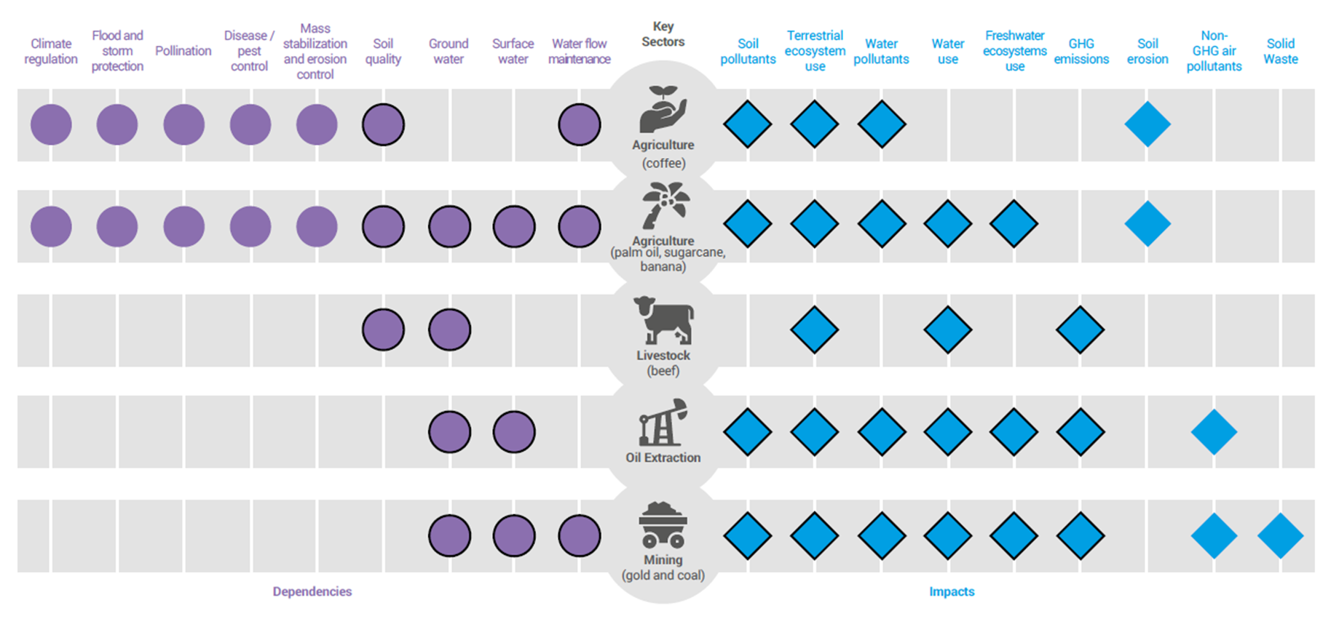
Where to start?
ENCORE: Interactions between high impact and dependency sectors - Colombia
Notes:
This is from ENCORE (Colombia analysis), the right hand side shows the impact of key sectors which put pressure on natural capital. The left hand side shows the ecosystem services that these same sectors use that are generated by natural capital. You can see that there is significant overlap between pressures on natural capital assets and the ecosystem service benefits that are need e.g. most sectors pollute water and soil but also rely on water and soil, so there are likely to be negative feedbacks within and between sectors where they are co-located. (the ENCORE database is not spatially specific) [NB – top sector on here is coffee, which Viet Nam exports a lot of]

Slide 26
Where to start?
Notes:
Hot of the press
Private finance needs to be consider in NBSAP
Goal D for the alignment of private finance with the goals and targets of the agreements; most of the world’s governments are considering how to engage this sector in the NBSAP.1
the private financial sector will play an increasingly important role in financing nature—because of increasing transparency of dependencies and impacts, and that public sector budgets are stretched. Indeed, public debt reached an all-time high of USD 92 trillion in 2022, presenting an acute challenge to many countries in meeting sustainable development goals.
By private finance, we refer to entities like banks, insurers, and investors including asset owners and managers that are owned entirely or majority by shareholders, without a government stake
Target 19 provides detail on closing the nature finance gap including private finance solutions, while Target 15 also specifically references the financial sector in terms of assessing and disclosing nature-related risks, dependencies, impacts and opportunities. Decision 15 / 7 on resource mobilisation encouraged Parties to develop financing plans (including private finance as relevant including removal of harmful subsidies), and decision 15 / 5 on the monitoring framework includes a number of finance indicators including D3 which tracks domestic and international private finance for conservation and sustainable use of biodiversity and ecosystems.

Slide 27
Sharing experiences Questions Challenges

Slide 28
Dr Shaenandhoa García Rangel
shena.garciarangel@unep-wcmc.org
Thank you

Slide 29
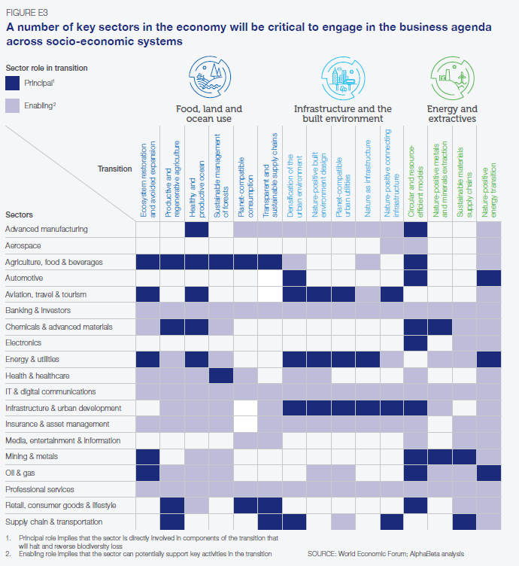
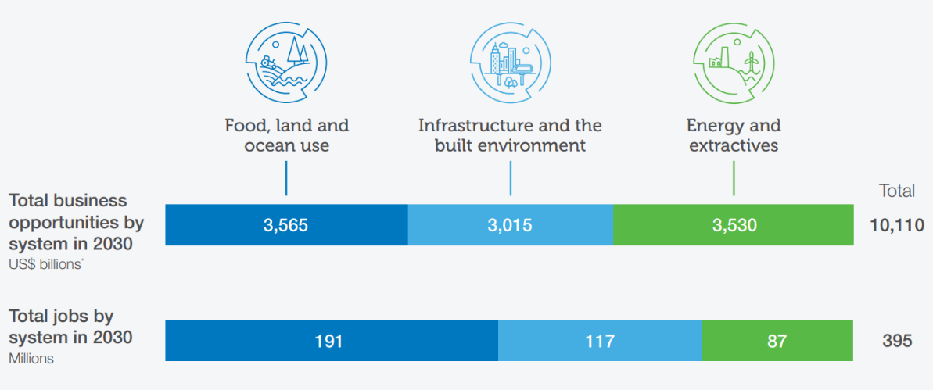
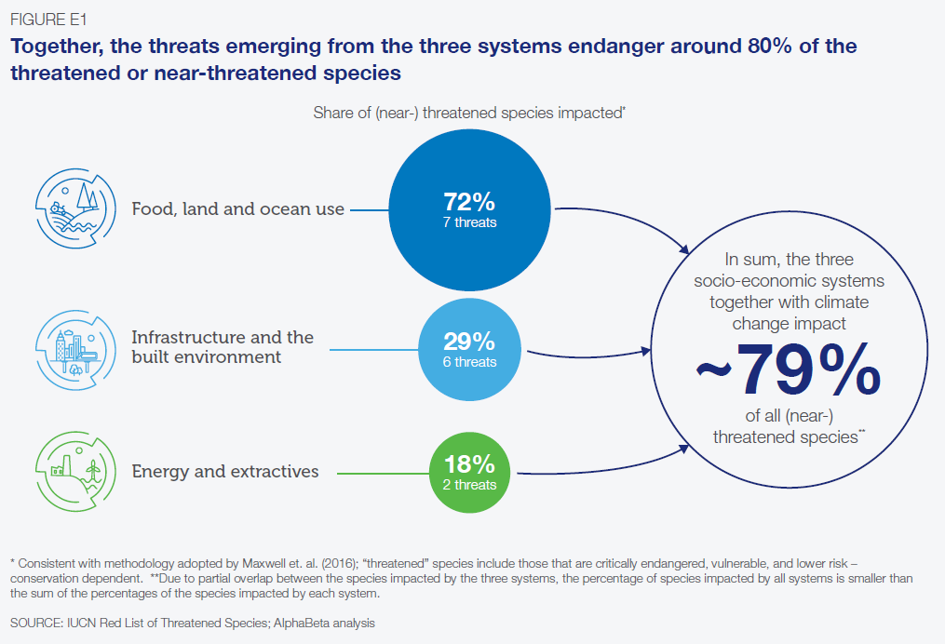
Where to start?
The Future of Nature and Business (2020)
Notes:
According to the WEF 80% of threatened and near-threatened species are endangered by Food, land and Ocean use, Insfrastructure development and the built environment and Energy and extractives posing the most significant business-related pressures to biodiversity; these are also where the largest opportunity to lead in co-creating nature-positive pathways.
In 2020 WEF outlined 15 systemic transitions (presented on the next slide) with annual business opportunities worth $10 trillion that could create 395 million jobs by 2030.
Together these transitions can pave the way towards a people- and nature-positive development that will be resilient to future shocks.
This image shows how the three socioeconomic systems can lead to total business and job opportunities by 2030.

